Slide 1
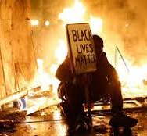
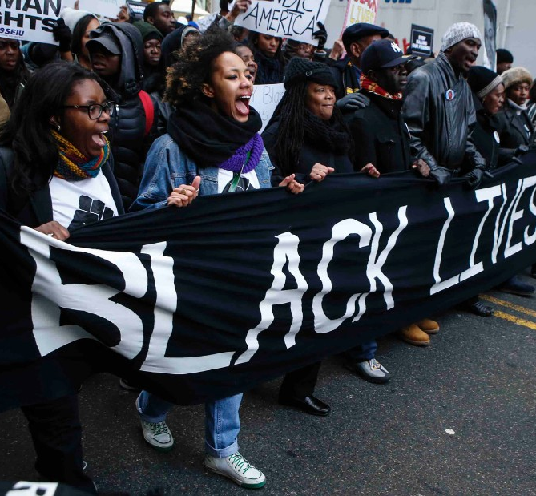
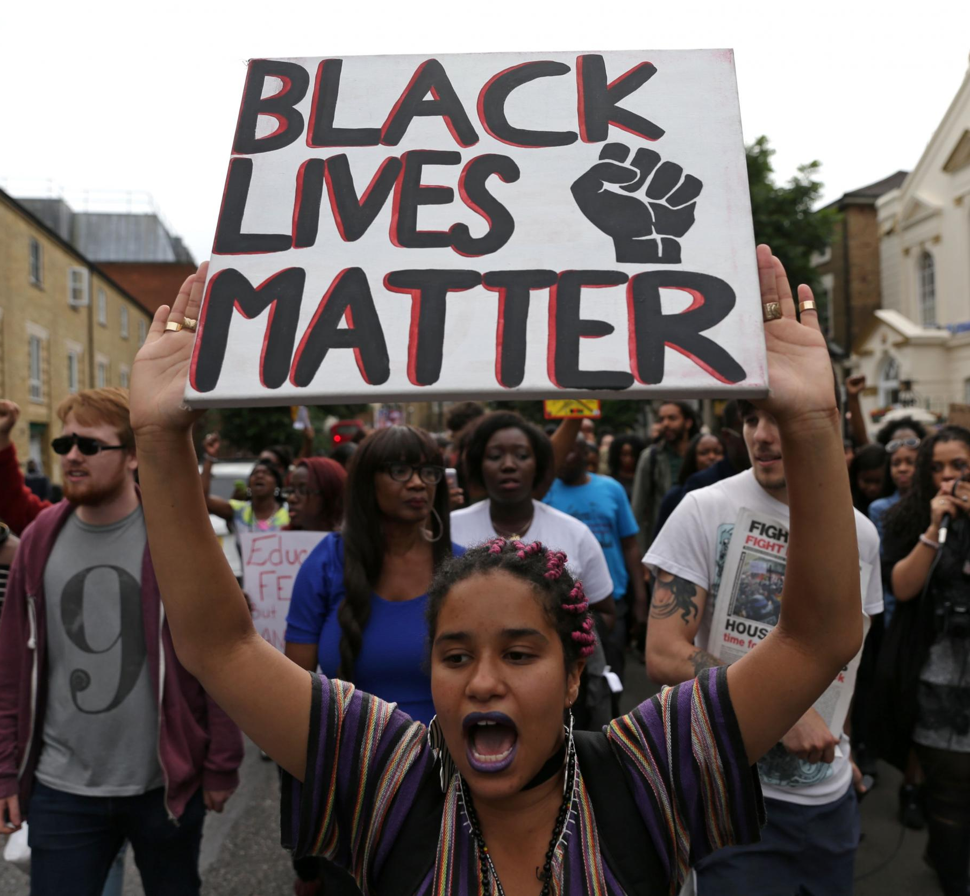
Black lives matter movement
By Adam koplik- block 3b

Slide 2
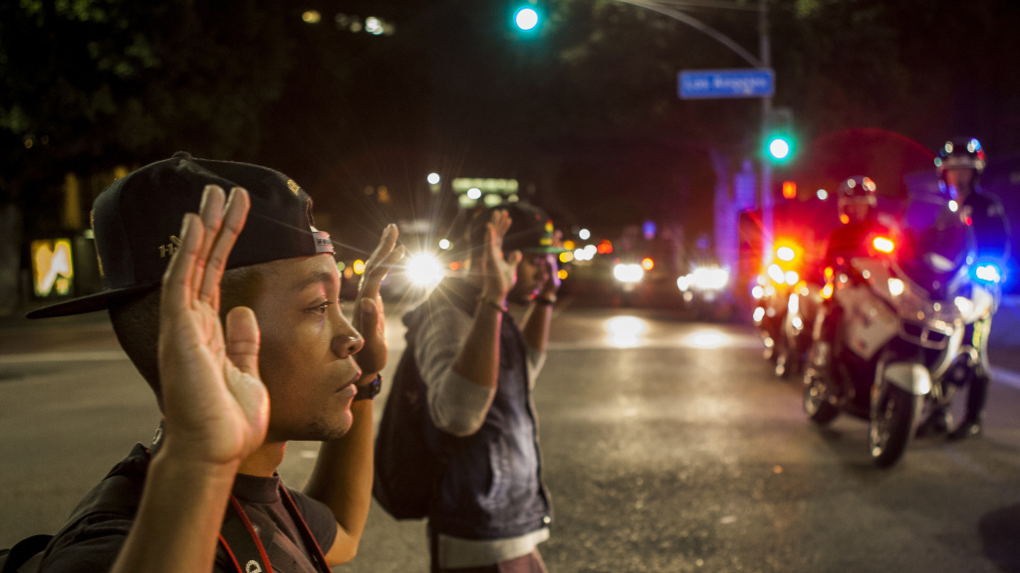
How did it start?
The movement started in 2013, protesting the acquittal of policeman George Zimmerman for the fatal shooting of Trayvon Martin.
In 2014, the shooting of Michael Brown sparked protests in Ferguson, Missouri. Black Lives Matter lead the protests, and emerged as a peaceful, non-violent group.
In 2015, two fatal incidents led to even more protests across the country. The shooting of Antonio Zambrano-Montes in Pasco, Washington, and the death of Freddie Gray after being beaten while arrested, led to more protests.

Slide 3
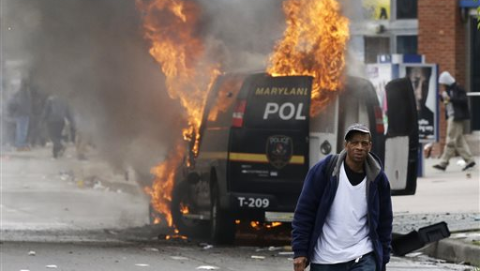
Protests turn to riots
As mentioned in the previous slide, 2015 was a very big year for the BLM movement. However, it was also the year they began to be less accepted, as the protests of Freddie Gray's death led to riots in Baltimore, Maryland.
In 2016, BLM was protesting the deaths of Alton Sterling and Philando Castile in Dallas, Texas. The protest had gone peacefully, but went sideways when Micah Xavier Johnson opened fire on the police officers manning the protest, killing five policemen, wounding seven, and injuring two civilians in the process.

Slide 4
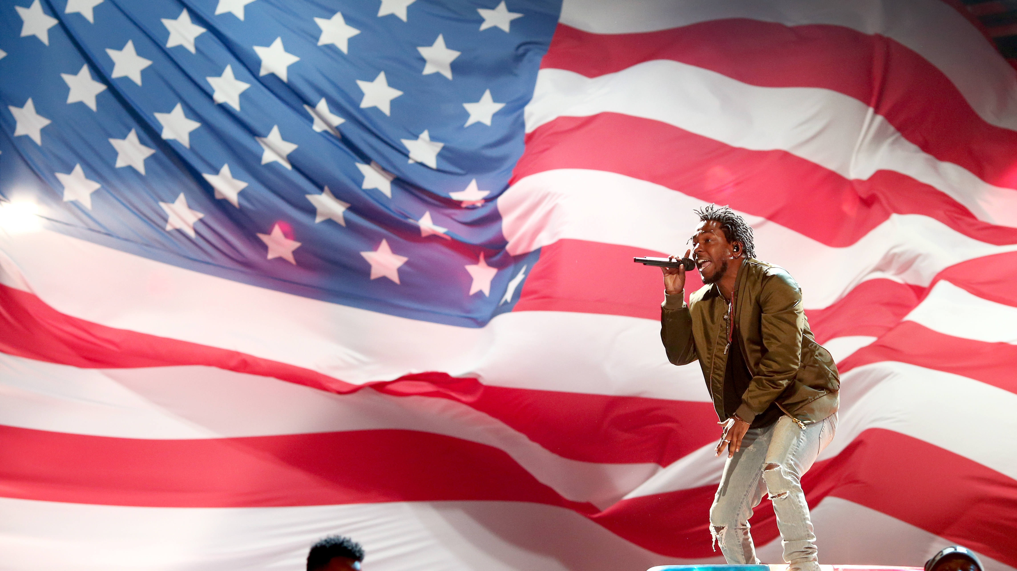
Kendrick lamar
Hip-hop artist Kendrick Lamar spoke out against racial inequality in his fourth studio album, entitled To Pimp a Butterfly.
In his hit songs "i", "Alright", "The Blacker the Berry", and "King Kunta", Lamar speaks out against both police brutality, and black on black crime.
During the 2015 BET Awards, Lamar jumped on the hood of a police car to protest brutality.
Lamar was both praised and scrutinized for his work, with Fox News correspondent Geraldo Rivera saying "“This is why I say that hip-hop has done more damage to young African-Americans than racism in recent years. This is exactly the wrong message.” in response to Lamar's performance at the BET Awards.

Slide 5
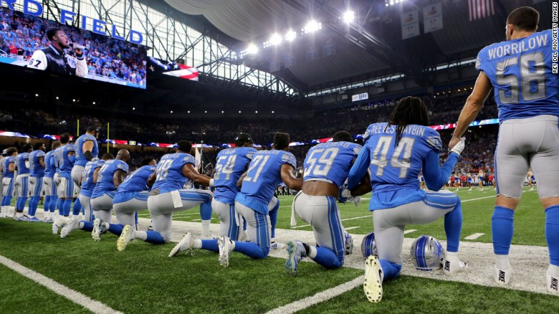
What's happening now?
The Black Lives Matter movement is in full swing with athletes across the country joining in on it.
Former San Francisco 49ers quarterback began kneeling for the National Anthem during last season to protest police brutality. This season it has taken full form, with players across the league either kneeling or locking arms with each other to protest inequality.
The movement was present at the Charlottesville protests, but it has begun to be unaccepted as a percentage of BLM participants have used violent acts to get their point across.

Slide 6
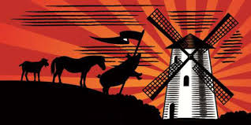
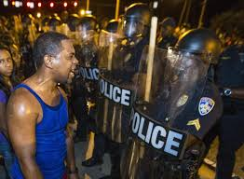
How does it relate to animal farm?
In Animal Farm by George Orwell, the animals start a rebellion because they feel they are not being treated as the human's equals.
Black Lives Matter was started because they believe that with police brutality, and other things, African-Americans are not being treated as equals to white people.
Both also started with a clear message, but a small percentage of the communities – like Napoleon and Micah Xavier Johnson – took it into their own hands to try to succeed, which made the problem even worse.

