Slide 1
Animal Abuse
By Ethan Palanca

Slide 2
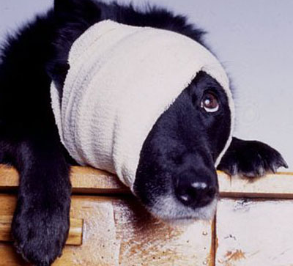
What is Animal abuse?
Animal abuse is when an owner of an animal or just a person hurts or kills there animal. People will do this if they are depressed or if they are anger. I believe that this is an awful thing that people do.

Slide 3
Protesters about animal abuse
There are big organizations that protest against animal abuse like the AFMA(Americans for Medical Advancement) and the AJP(Animal Justice Project). Somethings that these organizations did to protest against animal abuse are use a strong social media presence to get their message across, as well as more traditional press releases which distort current research.

Slide 4
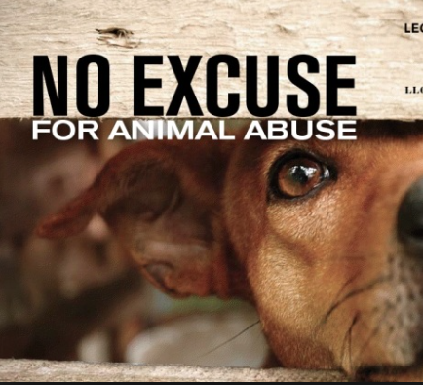
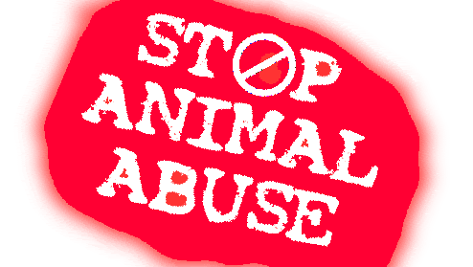
What do people do about it now?
Now in the world, they are starting to prevent animal abuse by making the punishments effect the person who did it big and awful. For example if someone hits there dog they could get a huge fee and could be sued. If someone kills an animal they could go to jail.

Slide 5
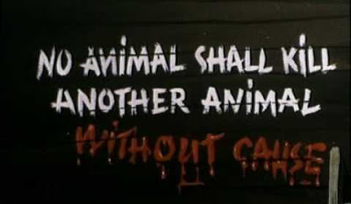
How this relates to Animal Farm
Animal abuse plays a part in the novel Animal Farm is when "the leader" of the farm Napoleon makes a law that "No animal shall kill any other animal" and then thinks that since that he is the leader so he can break it and kills animals. The rule in the novel is like the law in real life of animal abuse and when he kills them he breaks the rule like if people do it in real life they are breaking the law.

