Slide 1
Animal Testing
By Angelina Trapani-Banyra

Slide 2
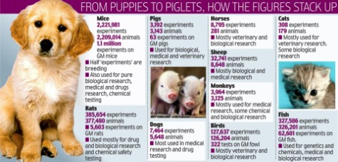
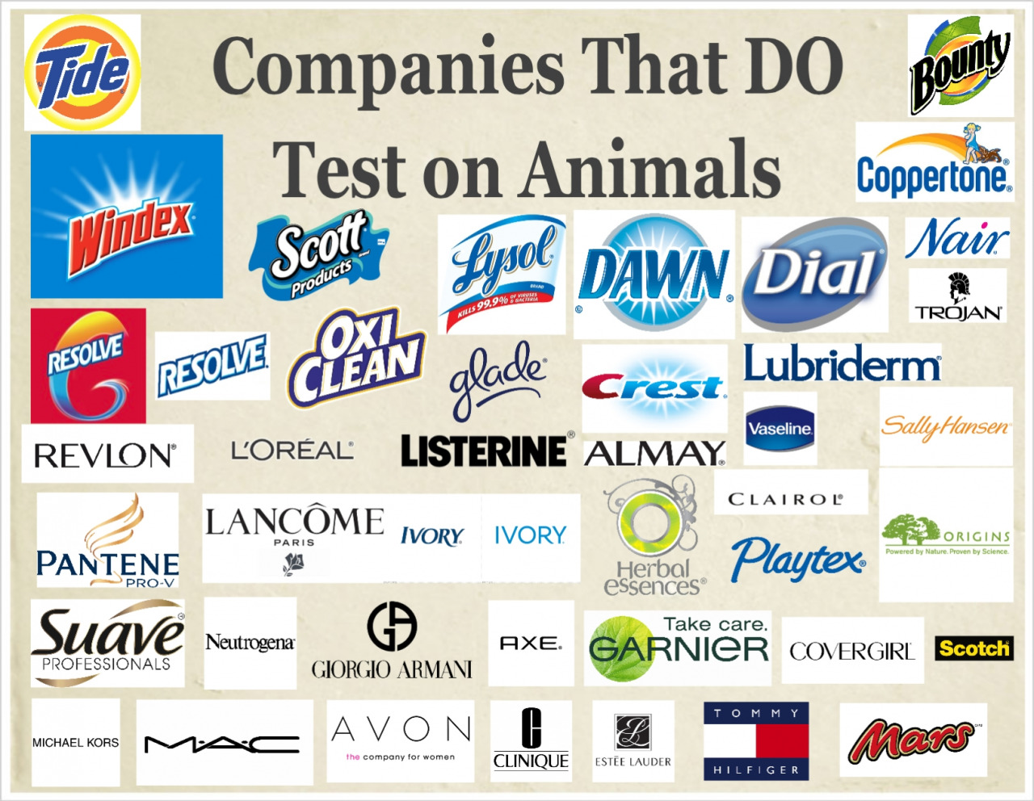
What is Animal Testing
Animal testing has been happening for many many years. Scientists and doctors have experimented on animals to see if products and drugs were safe to use on humans. Many people are surprised how may companies are associated with animal testing. Quite honestly, its horrifying.

Slide 3
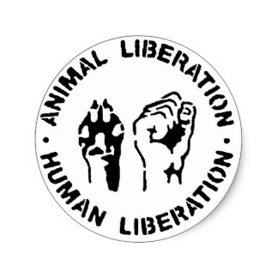
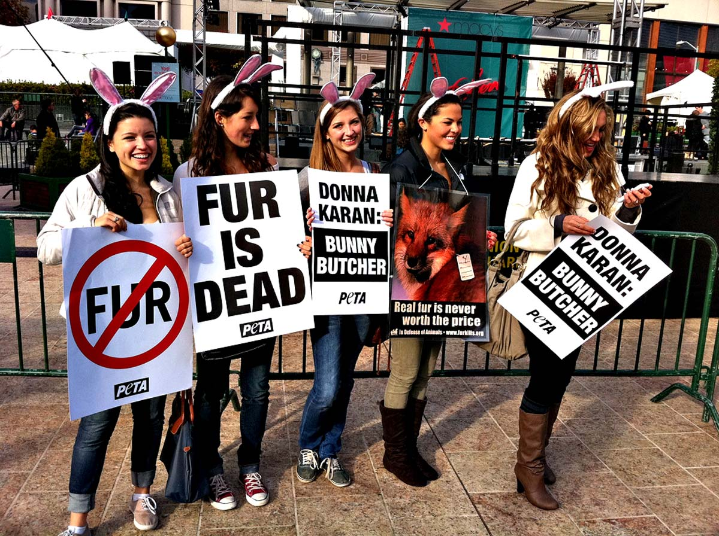
Protesters and Their Results
There are many protesters but the some of the most well known groups are the PETA (People for the Ethical Treatment of Animals), and the ALF (Animal Liberation Front). These protesters did many things like target circuses and other animal entertainment companies as well as threaten to bring some of these big problems to court. As a result of these protests Barnum & Baileys announced the retirement of their elephants, and Sea World in San Diego is replacing their killer whale show in 2017.

Slide 4
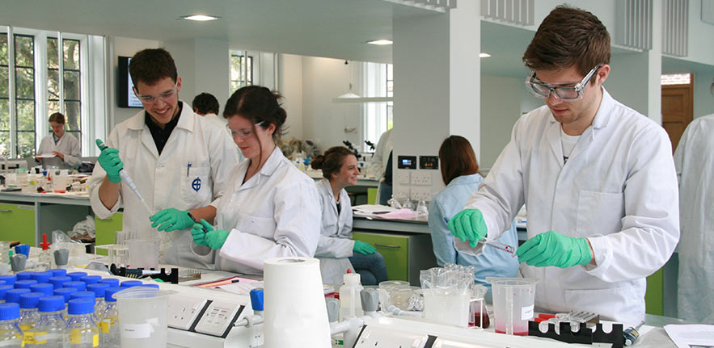
What's Happening Now
More people are now realizing the importance of animals lives. Scientists are now looking for alternative test subjects. For example they are currently in the process of trying to work out a way to use a chip that stores a single celled organism that holds the value of some of the major organs in the human body.

Slide 5
How this Relates to Animal Farm
Animal Farm can relate to animal testing through the pigs on the farm and the people of the world. In Animal Farm Napoleon thought it was ok to use other animals to benefit him because he thought he was better then the others, just like how we as humans put ourselves above the lives of animals by taking their lives to make sure our own isn't damaged. Also Squealer convinced the animals that the work they were doing was ok and fair by telling them they were doing it for the lives of animals to come after them, just how we say it was ok because we are saving "human" lives.

Slide 6
Work Cited
"PETA Makes its Case Against Animal Testing" Issues & Controversies.info base learning 2016. Wed.17 2016
"Animal Rights". Opposing View Online Collection. Detroit: Gale 2016. Opposing Viewpoints in Context. Wed. 11 Oct. 2016
Nogrady, Bianca."Animal Testing: Could it Ever be Banned Completely?" ABC Premium News. 19 Aug.(2016): n.p. SIRS Issues Researchers. Web. 20 Oct.2016

