Slide 1
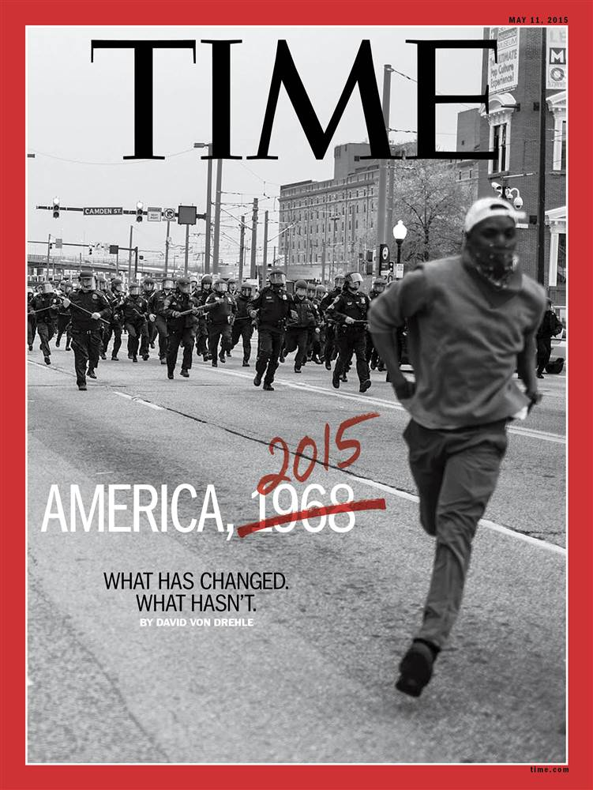
Black Lives Matter
Current event
By: Leah Blagbrough

Slide 2
Black Lives Matter
The Black Lives Matter movement is a national movement. It originally started as a hashtag, "#BlackLivesMatter" -On social media, Following the death of Trayvon Martin. In 2012 the unarmed teenager from Florida was accosted and then fatally shot by George Zimmerman. The killing led to months of ongoing protests, with people who have the same thing in common, wanting to end Racism. The people were mad at the police officers, for taking advantage of their power, and being racist.

Slide 3
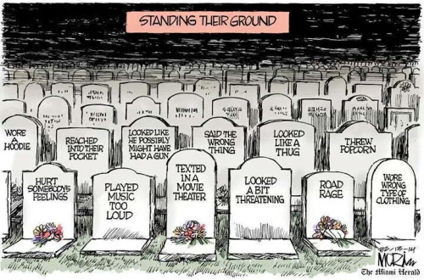

Slide 4
How did the government react?
Participants in the movement have been accused of nothing. Most of the Black Lives Matter protests have been calm and peaceful, but ever since the death of Freddie Gray protests have become violent. The Baltimore mayor called for peaceful protests and the violence was condemned by president Obama.

Slide 5
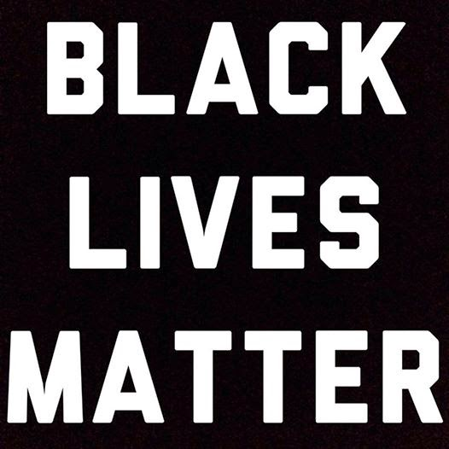
What is going on now?
The movement forced presidential candidates to reckon with a legacy of non racism, it lets people see if they are being racist around their surroundings. The challenge, for the movement is to stem the tide of the violence against black men and women while working to fix what activists seem to believe is fragmented and unstable. It Is an ambition that wont be easily archived. But as the movement evolves and expands, it has forced change

Slide 6
Black lives matter!!
#BlackLivesMatter
Was it all worth it?

