Slide 1
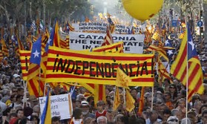
Protests In Catalonia
By: Joaquin Crosby-Lizarde

Slide 2
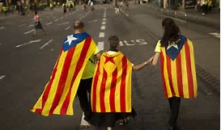
Causes to the protests in Catalonia.
The current protests started with the citizens of Catalonia feeling that their history, language and culture are different and unique to them, and not the same as the rest of Spain. Many citizens of Catalonia are impatient with the central government not responding to their needs, which eventually lead to them requesting a vote allowing them to secede and become their own independent nation.

Slide 3
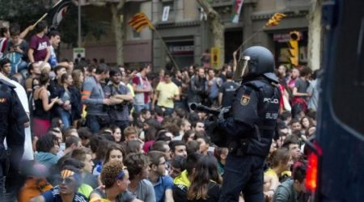
The current state of Catalonia
Catalonia is in an unsettling situation, which many people are calling the biggest test to their democracy since the death of the Spanish Dictator Franco in 1977. Catalonia as well as other regions of Spain are having many large protests that are in favor and not in favor of the secession. The government just stated as well that they will use force against protesters which is rising awareness and also fear in the Catalan protesters.

Slide 4
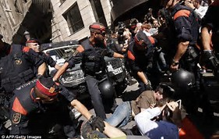
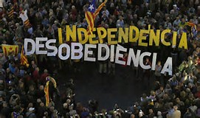
What’s in Catalonia's future?
Catalonia’s future is up in the air at the moment. The Catalonia referendum preliminary vote results showed about 90% of the citizens wanted independence. Out of the 2.26 million people who voted only 8% voted no for independence. The only issue is that many of the votes are still being counted, or were vetoed. Many other ballots were confiscated by officials so those are still being reviewed as of now. Catalonians are also protesting more then ever after the recent statement from the government saying they will use force against protesters.

Slide 5
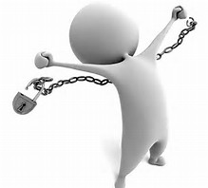
Napoleons similarities to Catalonia’s protests
Napoleon the pig has some similarities to the Catalonian protests, but one main similarity is they both want to be disassociated with their original rulers. Napoleon wants to be his own leader, in his own “nation” of animal farm, not under the rule of Jones/any humans. Catalonia wants to be their own nation and have their own ruler, and not be under the rule of Mariano Rajoy, the Spanish prime minister. They both want to be independent and have no relationship with their original leaders. They both in general want to be free.

