Slide 1
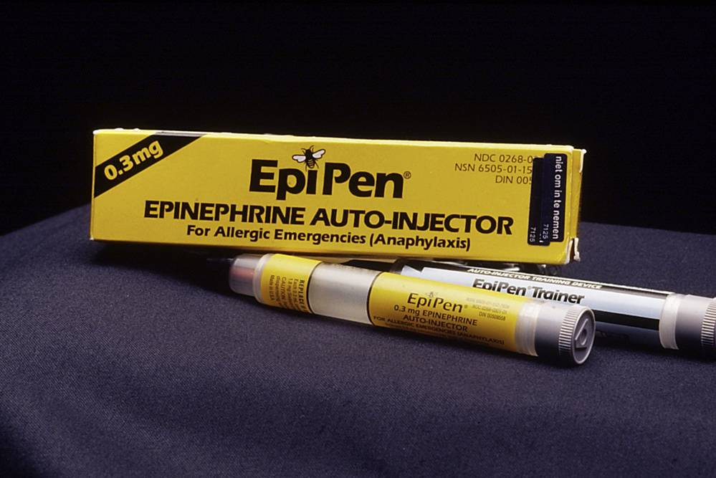
The Power of the Pharmacy
By Pilar Duvivier

Slide 2
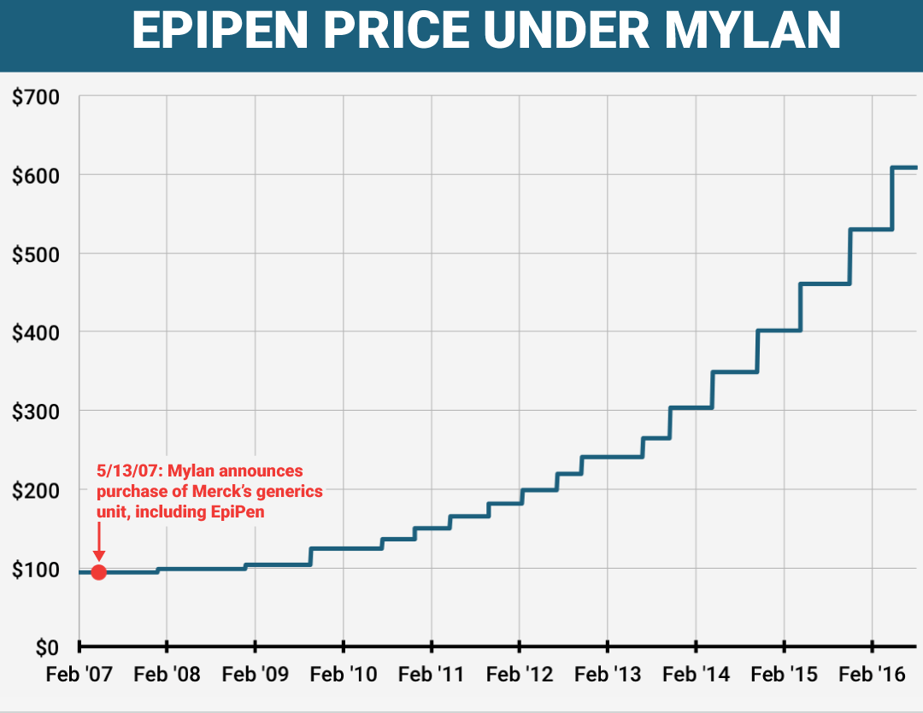
The Epipen Price
Over the last 8 years, the price of the epipen, a life-saving drug used to stop allergy attacks, has had a 500% price increase. Mylan, the company that makes Epipens, also increased the pay of their executives. Mylan's CEO Heather Bresch's pay went up 671% as the Epipen price increased as well. Not only is Mylan doing a price increase of their drugs, other companies are doing it as well. Daraprim, a drug used to treat HIV, went from being $13.50 a tablet to a whopping $750. The cost of generic prescription drugs has gone up 164% these past few years as well.

Slide 3
The Change
Mellini kantayya is an actress from brooklyn. She saw her friend facing a 600$ charge on Epipens. She was outraged to find out that the price had soared 500%, however since her insurance covered it for her husband, she wasn’t paying for it. Kantayya still wanted this price to go down, so created an online petition called "Stop the Epipen Price Gouging". Soon enough, 80,000 people sent over 121,000 letters to congress in efforts to stop the price gouging. These efforts were mostly run by parents and family members of people with food or other allergies. This is quite strange to see because usually patient advocacy groups would be vocal in a situation like this. However, some of these groups have been silent due to ties with Mylan.
Actress Mellini Kantayya

Slide 4
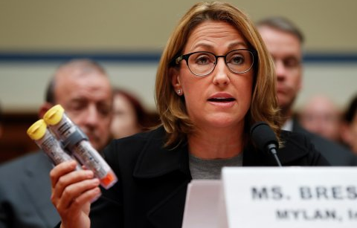
What happened next?
After all the 121,000 letters were sent to Congress, some change did occur. The awareness of the price gouging was taken up with some government officials. Senator Charles Grassley and Senator Amy Klobuchar both spoke out about the issue. It also caught the attention of Bernie Sanders and Hillary Clinton and they have also spoken about the issue, calling it outrageous. Sanders tweeted "There's no reason for an Epipen, which costs Mylan just a few dollars to make, should cost families more than $600". And after all this, Mylan did do something. With the help of some of the patient advocacy groups, they're working behind the scenes to get Mylan to expand its assisstence programs to make the epipen more affordable.
CEO of Mylan Heather Bresch

Slide 5
The Big Picture
After all these efforts to stop the price gouging, how much change is this causing in the long run? Most likely, little to none. The price of brand-name drugs has been and continues to rise. Plus, Mylan has not technically lowered the price of the Epipen at all, just expanded the assistance program. The average American pays about 858$ on prescription drugs, while people in other industrialized and advanced countries pay 400$. Many countries negotiate the price of drugs with the makers of them but in the United States, this is not possible. Congress has prohibited Medicare from doing this because it would set a benchmark for the entire system. The government even allows monopolies on pharmaceutical company's products. This allows them to control a certain part of the market, and charge whatever they so desire for that drug. This makes drug very expensive, however since the US is a capitalist country, these laws will take much more to change.

