Slide 1
Vietnamese fisherman protest
By Aidan Kirsch

Slide 2
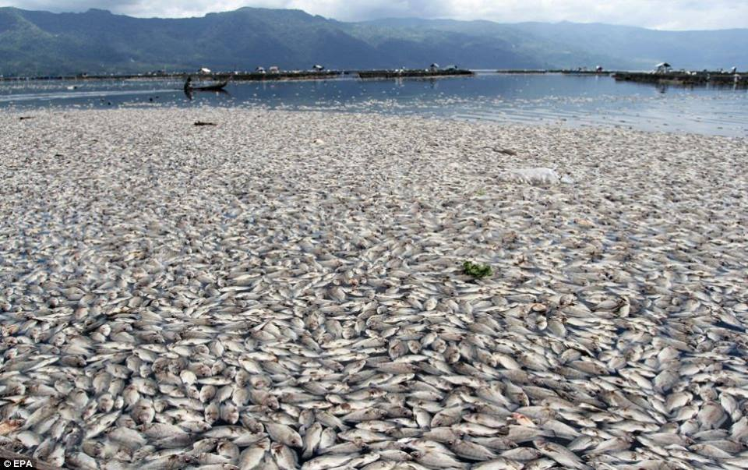
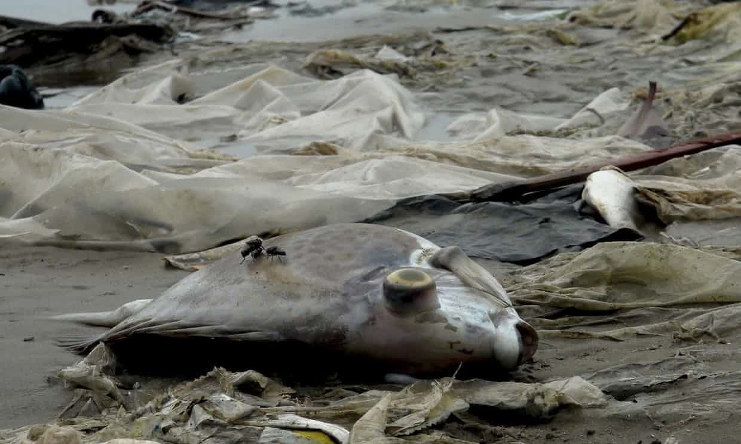
What Happened?
Taiwanese plastic company Formosa had an unexpected chemical causing over 70 tonnes of dead fish to wash up on the shores of Vietnam

Slide 3
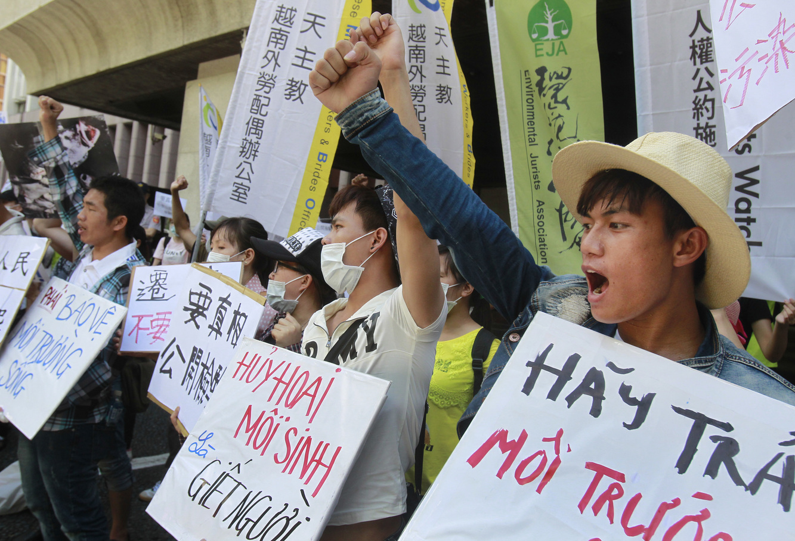
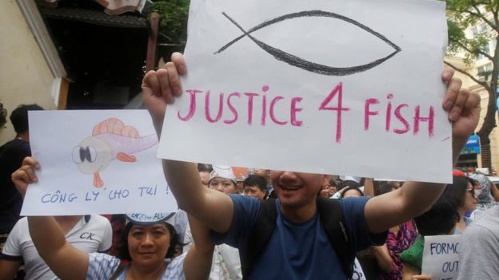
How Did the People React?
The people of Nghe An were the most badly affected so they organized a protest to travel from Nghe An to Hatinh.
Many other non violent protests occurred in small towns and at church. But non of which stood out enough to be covered by the news.

Slide 4
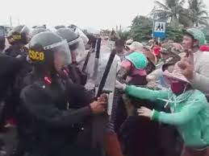
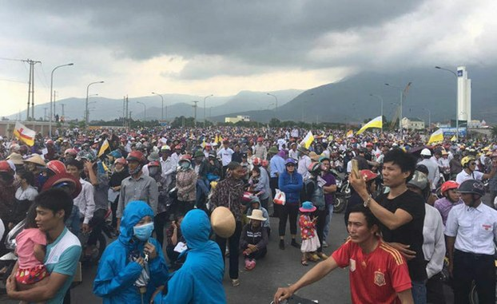
How Did the Government Respond?
The government did not respond well to the protest that was traveling from Nghe An to Hatinh. They stopped the cars of the protesters and after that did not work, because the protesters decided on travel on foot they became violent. Luckily only a few people were injured.

Slide 5
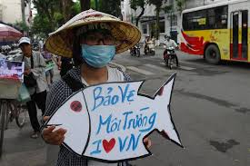
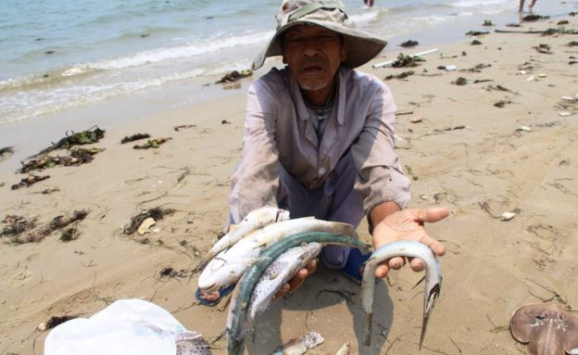
What's going on today?
Formosa has given money to and cleaned the ocean in three out of the four provinces it affected. The only one left is Nghe An and if they do not help soon the protests will become larger and more dangerous.

