Slide 1
Freudian psychology
This work has been curated by Mr. Neden. Some of the work has been made possible by the generous contributions of Mrs. Sutton.

Slide 2
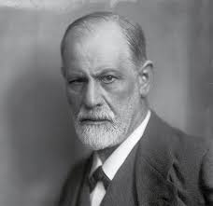
SIGMUND FREUD: THE FATHER OF PSYCHOANALYSIS
Freud redefined the way people thought about the world and about themselves. He said his aim in life was to "agitate the sleep of mankind."
He succeeded in his aim, founding a new field of psychology and creating a new, scientific conception of the individual.

Slide 3
He initiated a new, exciting, and often threatening theories of the mind and of the world.
---------------------------------------
Today we will examine some of his more prominent theories:
The conscious vs. the unconscious mind
The id, the ego, and the superego
The Oedipal Complex

Slide 4
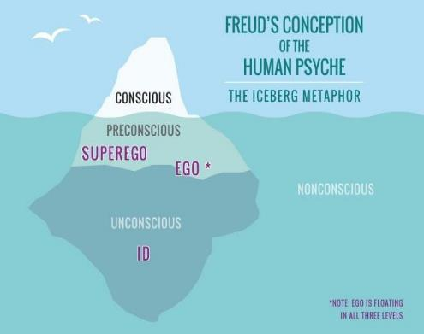
FREUD'S DIVISION OF THE MIND
Freud understood the mind as constantly in conflict with itself, and understood this conflict as the primary cause of human anxiety and unhappiness.

Slide 5
Conscious Mind vs. unconscious Mind
The thoughts, memories, feelings, and wishes of which we are aware at any given moment.
This is the aspect of our mental processing that we can think and talk about rationally.
A part of this includes our memory, which is not always part of consciousness but can be retrieved easily at any time and brought into our awareness.
The reservoir of feelings, thoughts, urges, and memories that outside of our conscious awareness. Most of the contents of the unconscious are unacceptable or unpleasant, such as feelings of pain, anxiety, or conflict.
According to Freud, the unconscious continues to influence our behavior and experience, even though we are unaware of these underlying influences.
The unconscious can include repressed feelings, hidden memories, habits, thoughts, desires, and reactions
Source: www.verywellmind.com

Slide 6
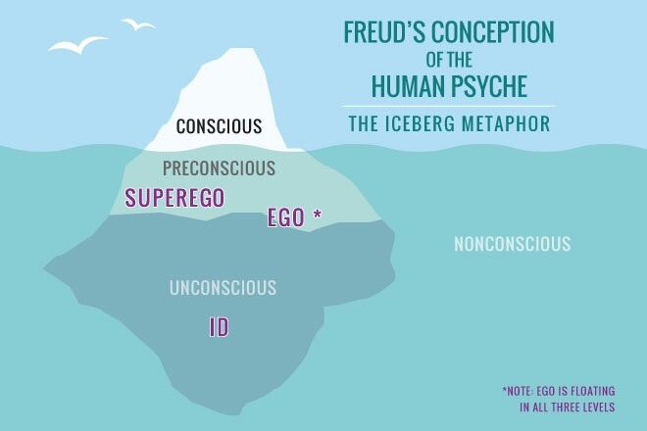
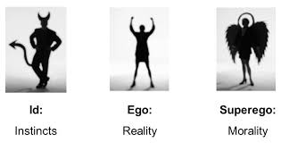
The id, the ego, and the superego
The superego is the part of a person's mind that acts as a self-critical conscience, reflecting social standards learned from parents and teachers.
The ego, which is ruled by the reality principle. The ego acts as a go-between in the id's relations with reality, often suppressing the id's urges until an appropriate situation arises.
The id demands immediate gratification: it is ruled by the pleasure principle, demanding satisfaction now, regardless of circumstances and possible undesirable effects.

Slide 7
The id, the ego, and the superego

Slide 8
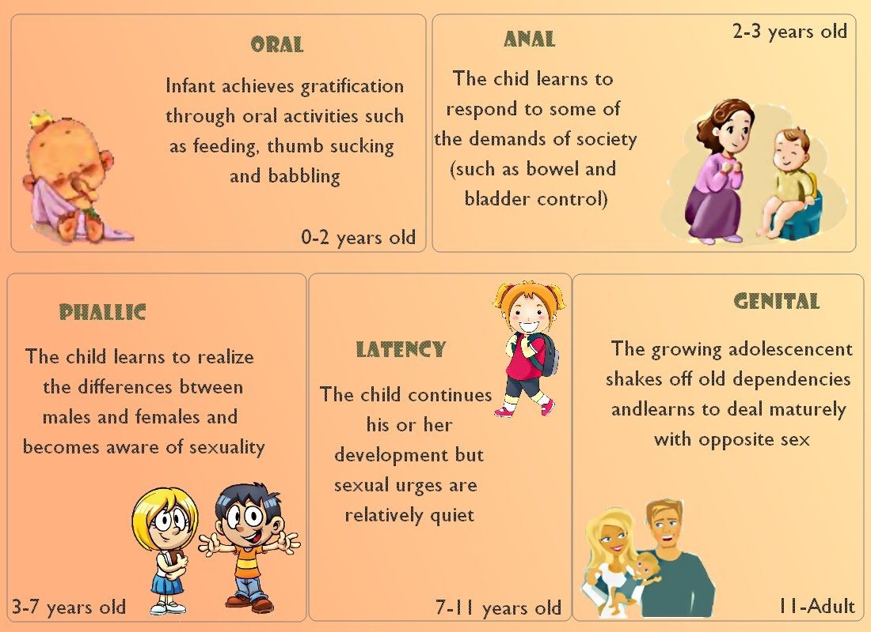
FREUD'S PSYCHOSEXUAL STAGES OF DEVELOPMENT
Freud advanced a theory of personality development. At particular points in the developmental process, he claimed, a single body part is particularly sensitive to sexual, erotic stimulation.

Slide 9
The Oedipus complex
“Don’t be afraid that you may marry your mother. Many a man before you, in dreams, has shared his mother’s bed” (53).
The conflict, labeled the Oedipus complex (The Electra complex in women), involves the child's unconscious desire to possess the opposite-sexed parent and to eliminate the same-sexed one.

Slide 10
Oedipal Complex vs. Electra Complex
In the young male, the Oedipus conflict stems from his natural love for his mother.
Unfortunately for the boy, his father stands in the way of this love. The boy therefore feels aggression and envy towards this rival, his father, and also feels fear that the father will strike back at him.
As the boy has noticed that women, his mother in particular, have no penises, he is struck by a great fear that his father will remove his penis, too.
This castration anxiety outstrips his desire for his mother, so he represses the desire.
On the Electra complex, Freud was more vague.
The complex has its roots in the little girl's discovery that she, along with her mother and all other women, lack the penis which her father and other men posses.
Her love for her father then becomes both erotic and envious, as she yearns for a penis of her own.
She comes to blame her mother for her perceived castration, and is struck by penis envy, the apparent counterpart to the boy's castration anxiety.
According to Freud, The Oedipal/Electra Complex is prominent during the phallic stage of development and is only suppressed by the superego, the voice of the father within the boy. By thus resolving his incestuous conundrum, the boy passes into the latency period, a period of libidal dormancy.

Slide 11
The Oedipal Complex again…

