Slide 1
GUN CONTROL ISSUE
By Maya Gehris
Block 1A

Slide 2
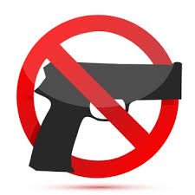
The Issue
One of today's most prominent issues is gun control, this topic has caused a division between the country and has become extremely controversial, effecting the countries way of resolving major conflict. There are a variety of resources available to try and make this issue a less prominent one.

Slide 3
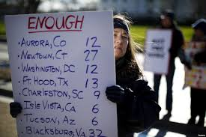
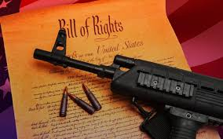
Different solution ideas
Some believe that the solution to this continuous issue would be to abolish the second amendment, while others think that the issue is not out of hand and less strict gun laws might prevent people from wanting to rebel against federal regulation. Some also believe that even if stricter rules were to apply, it would not prevent gun violence rates, nor would making the purchase of weapons more difficult.

Slide 4
Major organizations
There are a variety of large organizations in the country that specialize in maintaining gun violence levels down, some of these organizations such as the Coalition to Stop Gun Violence and Everytown for Safety, focus heavily on lessening the rates of firearm abuse, particularly in school systems.

Slide 5
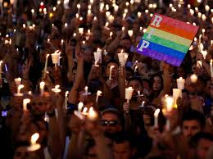
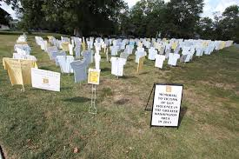
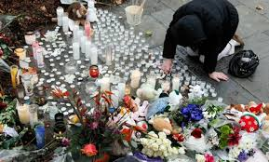
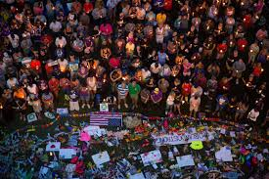
Political standpoints
While politics continue to discuss, debate, and argue about gun control, little seems to actually have been done. This topic has also continued to surface throughout the presidential election, again dividing a thin line between the country and the individual beliefs. While this issue is certain politician's top priority, others have chosen to focus on what they believe to be more pressing issues.

Slide 6
Virginia tech
After the major shooting at Virginia Tech, where 32 people where killed and 17 injured, the school has strived for safer campus gun control, and is encouraging other schools to do the same.
This school has been striving to pass rules across the country to gain better gun control for collage campuses to prevent tragic and devastating events from reoccuring in the future.

