Slide 1
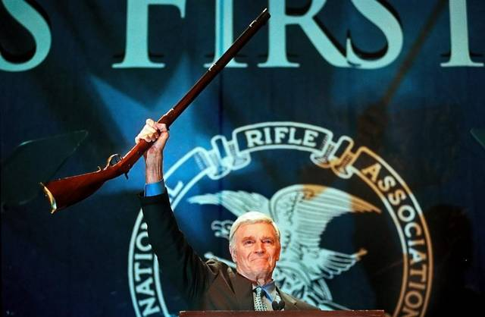
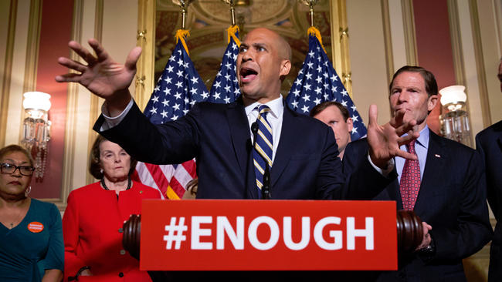
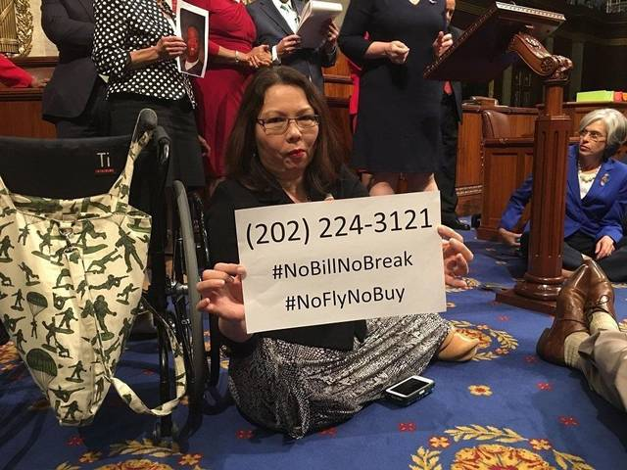
Gun Control
By adelaine morgiewicz

Slide 2
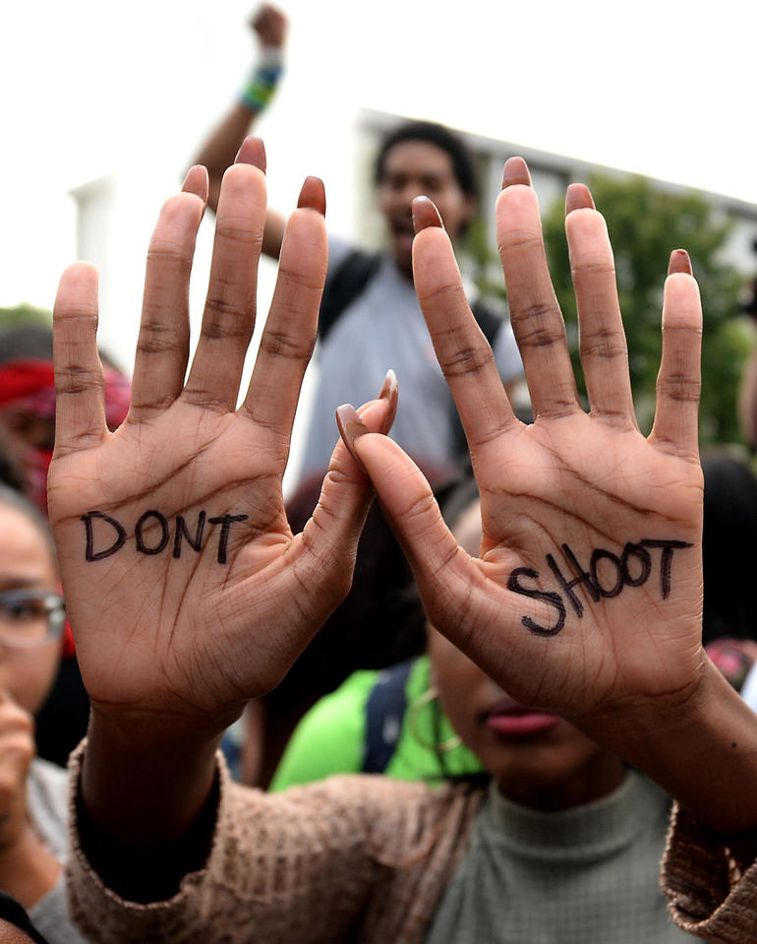
Causes of debate over Gun Control
There were many shootings and killings in places such as: Chicago, Charlotte, Orlando, Connecticut and others. Omar Mateen killed 49 people and wounded 53 in the Orlando Gay Night Club. In Connecticut, 20 students and 6 teachers were killed. Some people are calling these events killings/shootings, while others are calling it terrorist attacks. All of these have caused debate over the NRA (National Rifle Association), the Democratic and Republic House of Representatives Congress, House Majority Leader, House Minority Leader, the senators, House speakers, , and just plain Democrat's and Republicans. Debates over Gun Control also lead to speeches and lots of protests.

Slide 3
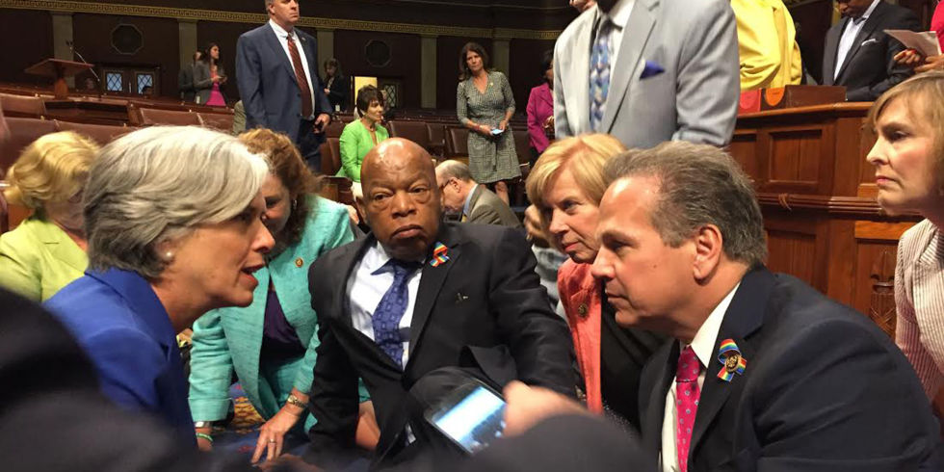
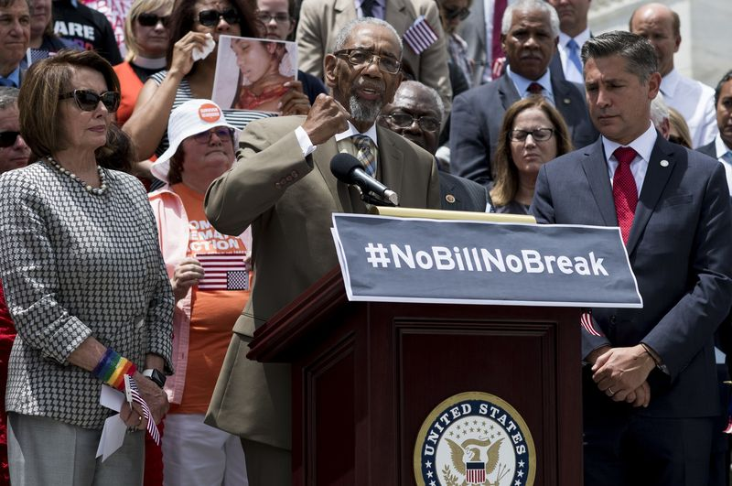
The Sit-in/During
The sit-in happened on July 4th, a Wednesday evening where the U.S. Congress (Democrats) staged a sit-in to demand a vote on Gun Control Legislation. There were about 168 house democrats and 34 senators sitting on the House floor. They held up signs that said #NoBillNoBreak and #HoldTheFloor. They had also sung the song: "We Shall Overcome", along with signs of the names of the gun attack victims. Speaker Paul Ryan tried to keep them under control, but then he left once they started to yell words like: "Shame! Shame!" And "No bill, no break!"Republicans switched off cameras, but yet the Democrat's still remained. They stayed throughout the whole night, with some ordering pizza, and bringing sleeping bags to them.The republicans voted throughout the number of bills, and decided to grant them no vote.

Slide 4
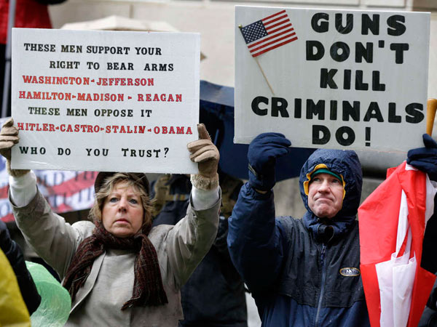
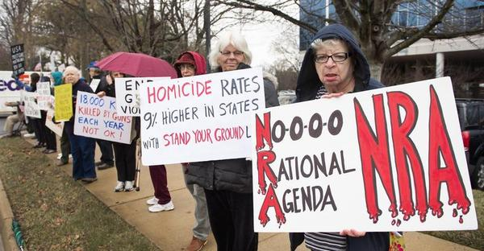
The Democrats v.s the republicans side of view
The democrats:
-believe that there should be gun control
-REASONS: tons and tons of shootings and killings, schools getting shot, along with children and people targeted at; Orlando, Chicago, Connecticut, etc.
BOTH:
-Both sides (republicans and democrats), use the second amendment to argue. Example: Democrats say that the right to bear arms is subject to reasonable regulation, where as Republicans say it is their right to bear arms as it states in the second amendment.
The Republicans:
- believe that there should not be Gun Control
-REASONS: They want the right to bear arms, the second amendment, would like to defend themselves.

Slide 5
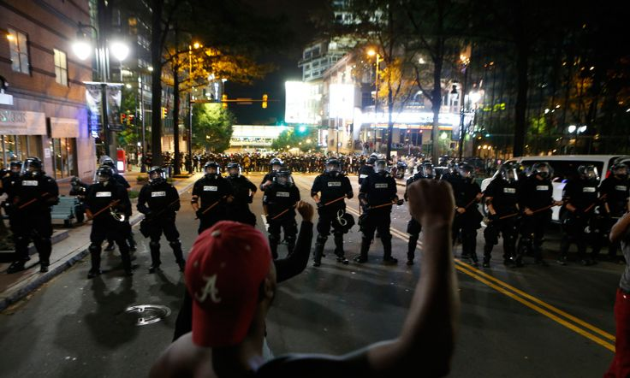
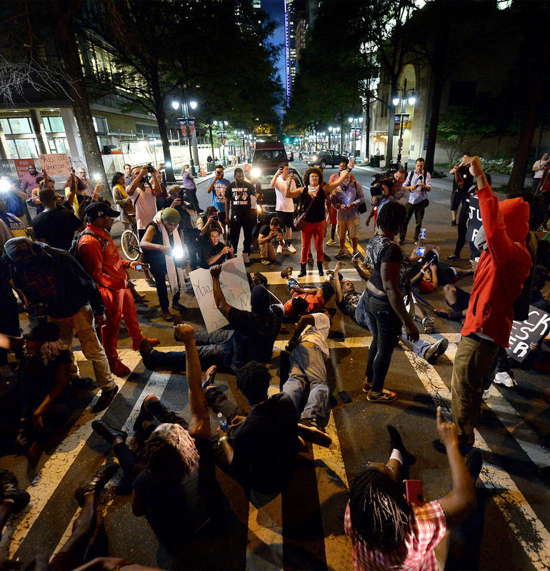
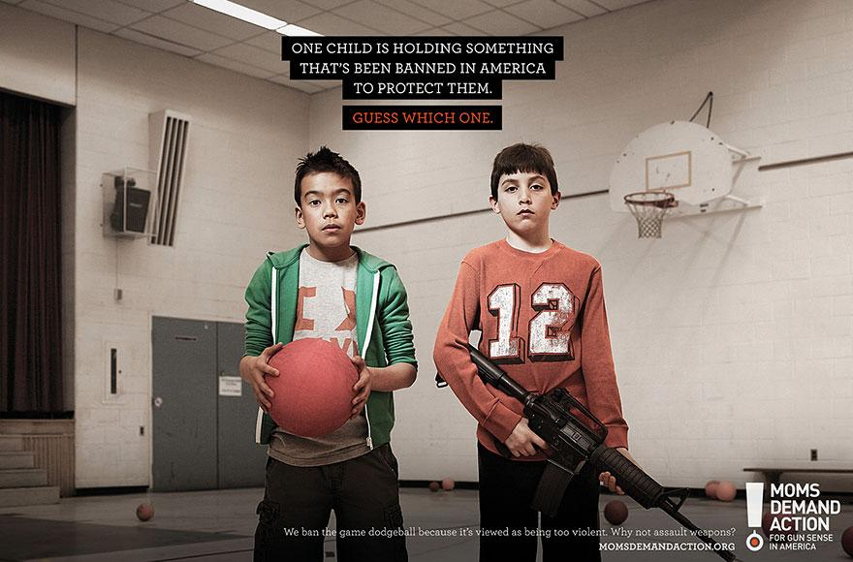
Today/What's going on Now
There still is debate over Gun Control in the U.S., and will probably continue.
People will always have their opinions, on any issue. Donald Trump thinks that only "good guys" should be allowed to have guns. Hillary believes that there should be protection (Gun Control), and background checks. It will most likely be hard for the Republicans to fight for their view on Gun Control, but who knows? It will probably be easier for the Democrats because of all the killings and shootings that they could use for multiple facts, but maybe it won't. Because both ways have to do with America's Freedom, and its Power, technically both sides could be right. Maybe Gun Control will be a benefit, maybe not.

