Slide 1
The Handmaids' Resistance
Ella Schwartz

Slide 2
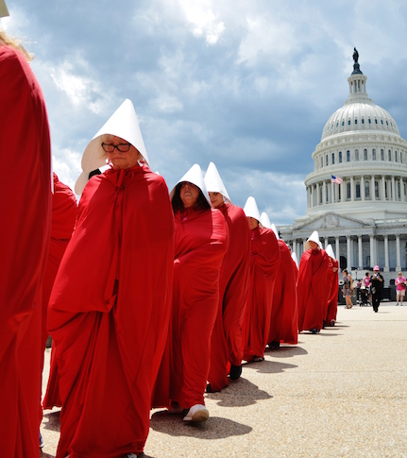
What Happened?
On June 29th, 2017 a group of about thirty women dressed in red cloaks and white bonnets as characters from Margaret Atwood's novel, "The Handmaid's Tale", walked the US Capitol grounds to protest the proposed GOP health care bill.

Slide 3

Why March?
The plan to repeal and replace the Affordable Care Act wouldn't allow funding to help people purchase insurance plans that include coverage for abortions. States wouldn't be allowed to use direct spending on "prohibited entities", which include family planning services, reproductive health, and related medical care or abortions unless the life of the mother is at risk or in instances of rape and incest.

Slide 4
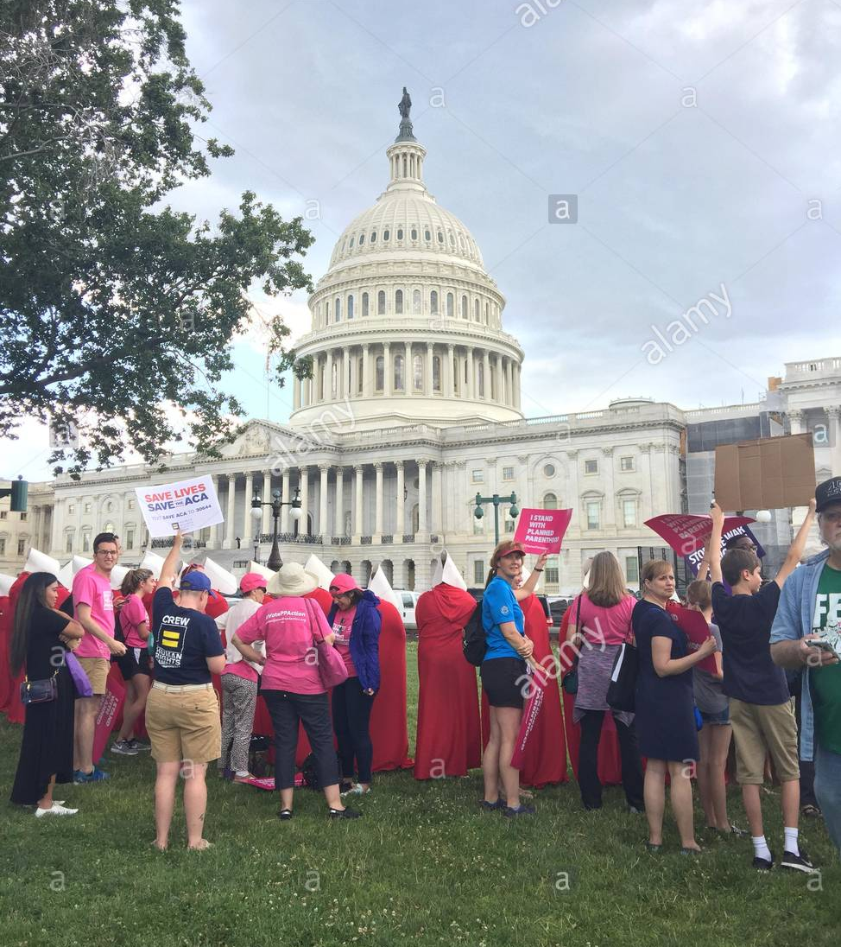
Planned Parenthood
Planned Parenthood organized the event in response to Trump's inauguration, and had the volunteers dressed as handmaids stand silently in front of the Capital. This created an environment where bystanders asked Planned Parenthood volunteers not in costume about ways in which they could help and become more informed.

Slide 5

Government Response
The government has continued to move forward with its dismantling of the Affordable Care Act (Obamacare), and in turn the defunding of Planned Parenthood. The attempts thus fare, haven't come to fruition.

Slide 6

Was it worth it?
Yes, it most certainly was worth it. Awareness has been raised, and the GOP understands that Planned Parenthood and women's rights activists will not rest and cease fighting until they are heard and laws kept in place.

