Slide 1
JOURNALISM IN 2018 AN OVERVIEW OF THE ISSUEs WE FACE

Slide 3
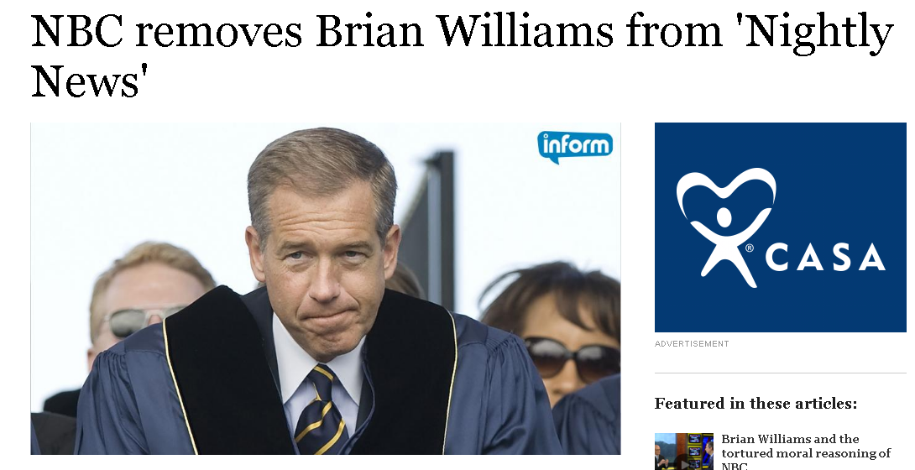

Slide 4
https:///

Slide 5
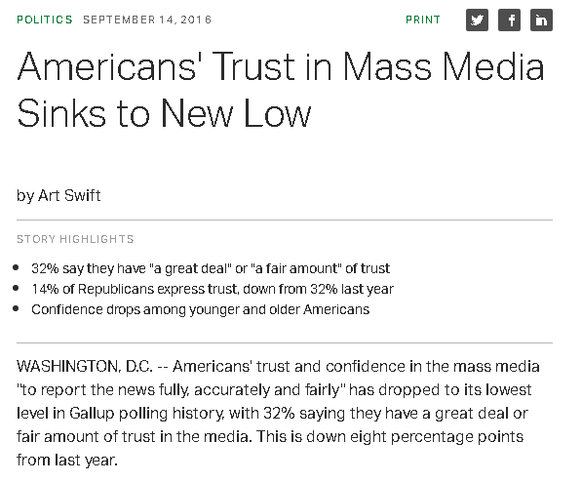

Slide 8
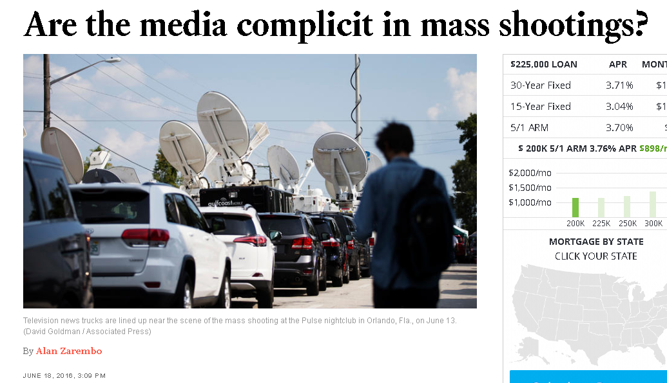

Slide 9
John Stewart—The DAILY SHOW

Slide 11
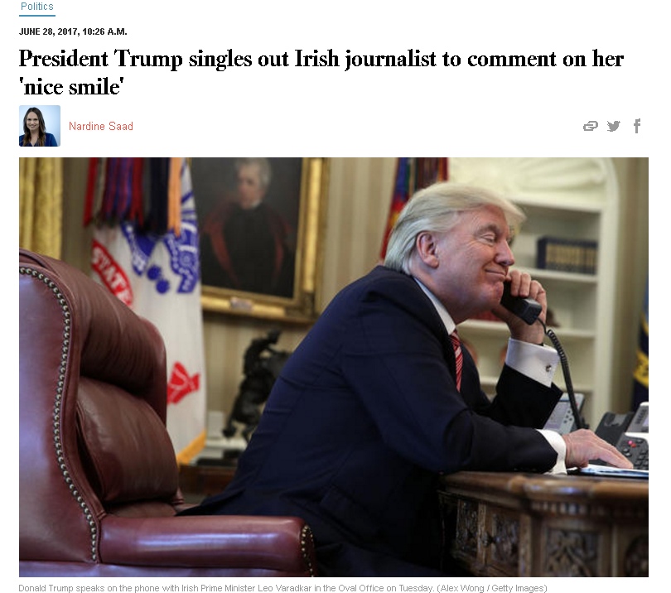

Slide 12
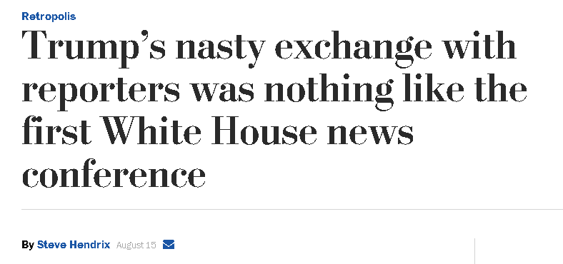

Slide 14
Trump’s Initial Attack on the Media May 2016

Slide 15
Trump’s attack on cnn “You’re fake news”
January 11, 2017
NY TIMES LINK: Kristof

Slide 16
Trump attacks the media summer 2017
Post Charlottesville, VA.

