Slide 1
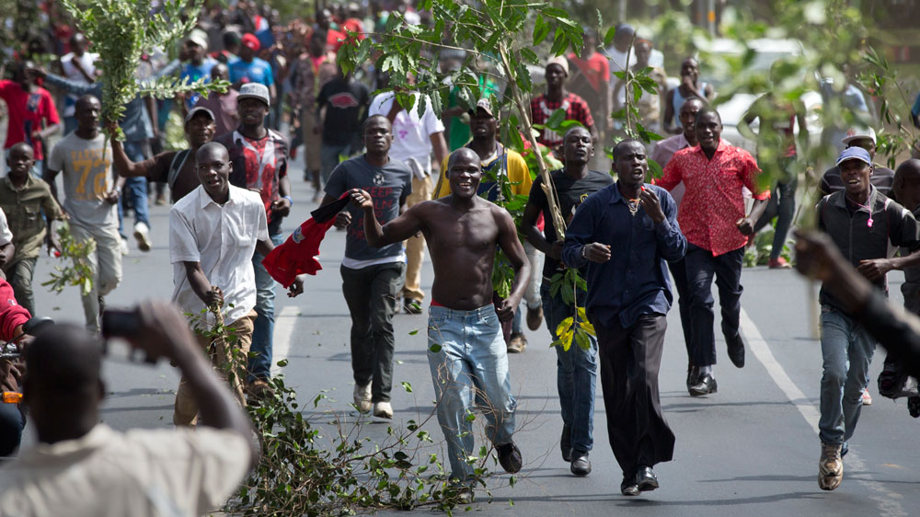
Kenya Protest
Jack Hyland

Slide 2
Before the Revolution (Election)
There was an election that happened in Kenya on October 11, 2017 for a president.
There was thought to have hacking involved in the outcome of the election.
This made people angry because Kenya still told everyone that Uhuru Kenyatta (candidate) was their president even when Kenya couldn’t prove the election wasn’t rigged or hacked.

Slide 3
During the Revolution (Protests)
People involved in this situation where the candidates Uhuru Keyatta, Ralia Odinga, Kenya Protesters, and Kenya police.
There was a big spontaneous protest that happened in an area of mad civilians.
The police eventually showed up and where not very kind. The police acted very violently and killed over 30 people while injuring many more.
Protests where then made illegal.

Slide 4
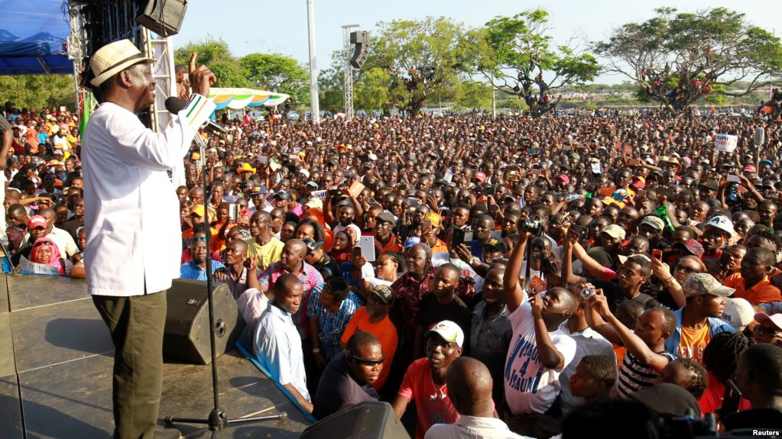
After Math
The other candidate (Ralia Odinga) then withdrew from the election and encouraged protests.
Kenya eventually decided to do a reelection because of the protesters.

Slide 5
Animal Farm
This event was similar to the book Animal Farm because there was unfair election in Kenya and Napoleon toke over without winning a vote.
People were also killed by police for protesting and in Animal Farm some farm animals were murdered by the dogs (police) for thinking about revolting.

