Slide 1
Kneeling at the flag
Colin Kaepernick starts a viral protest during a NFL game.

Slide 2
Kneeling at the flag
Colin Kaepernick took to one knee during the national anthem when he played for the San Francisco 49ers, in protest of police brutality against black Americans.

Slide 3
What did the government think?
After, Donald Trump, who calls anyone who kneels a “son of a bitch” and N.F.L. players who had chosen to “disrespect” the flag or country by kneeling during the national anthem. VP Pence left a NFL game when he saw the players kneeling at the flag. Players are putting their jobs at risk by doing this, as NFL threatens to fire the players that kneel.

Slide 4
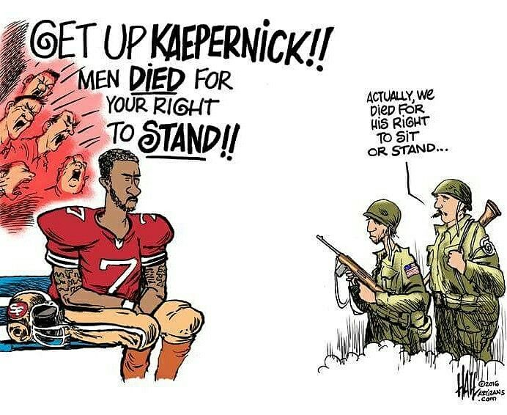
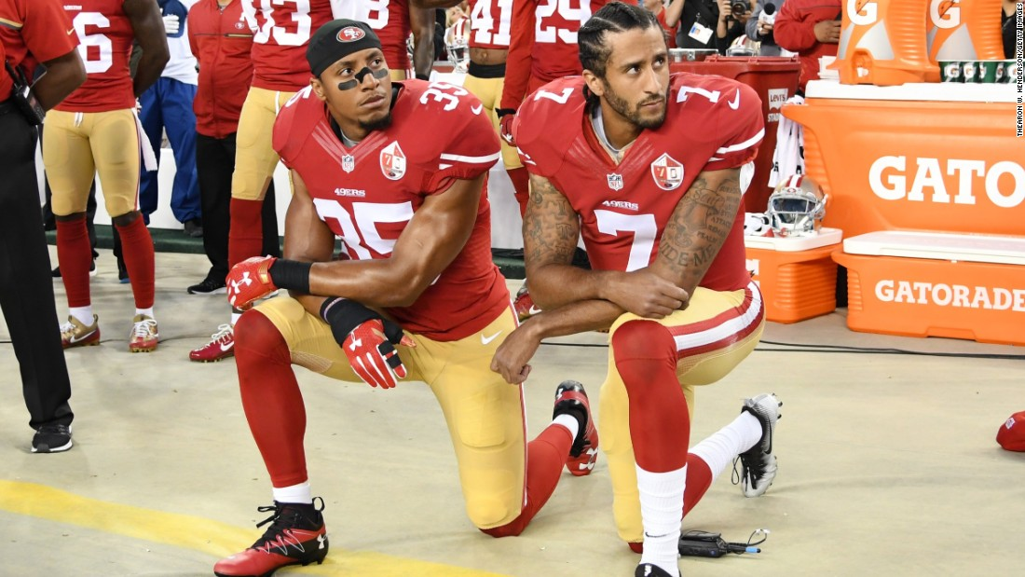

Slide 5
How does this relate to Animal Farm by George Orwell?
I see Colin Kaepernick as Old Major. Kaepernick sees that America is not treating everyone equally or how they should be treated, just like Mr. Jones and Manor Farm. Manor farm is America, and Old Major is Colin Kaepernick. The humans in Animal Farm are the people who find kneeling absolutely absurd, and the animals on the farm are the people who agree with Kaepernick

Slide 6
