Slide 1
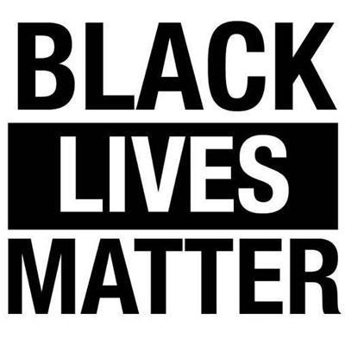
Black lives matter
Current event
By Mayson Forstell

Slide 2
Why and when the "Black lives matter" protest started
According to https://blacklivesmatter.com/about/herstory/ the protest started In 2013, three radical Black organizers—Alicia Garza, Patrisse Cullors, and Opal Tometi- stared a black centered political will and movement using the hashtag #BlackLivesMatter. It was in response to the death of Trayvon Martin. Trayvon Martin was shot by George Zimmerman.

Slide 3
Some political cartoons about how people perceive blacks and the protest that they have.

Slide 4
How did the government react?
https://www.cbsnews.com/news/white-house-responds-to-petition-to-label-black-lives-matter-a-terror-group/
In the year 2016 the White House responds to petition to label Black Lives Matter a "terror" group and defines there dumb and horrible descion by saying that "After days of violence and heightened racial tensions in the U.S., the White House responded this week to an online petition asking the federal government to formally label the Black Lives Matter movement as a "terror group."
"Terrorism is defined as 'the use of violence and intimidation in pursuit of political aims,'" read the "We The People" petition, created July 6 on the White House website. "This definition is the same definition used to declare ISIS and other groups, as terrorist organizations."
Black Lives Matter, the petition said, "earned this title due to its actions in Ferguson, Baltimore, and even at a Bernie Sanders rally, as well as all over the United States and Canada." It asked the Pentagon to recognize the group as such "on the grounds of principle, integrity, morality, and safety."
But during the Chaolets Ville protest when the white supremacy was walking around with guns and torches they were not labeled as a terror group even though they defiantly scared people to their advantage.

Slide 5
What is happing now with the protests
The protest are still happing alongside police brutality protest all though out the country from New York to San Jose.

Slide 6
Will black people have justice? Will it be worth it some day?
Because BLACK LIVES MATTER!!!!!!!

