Slide 1
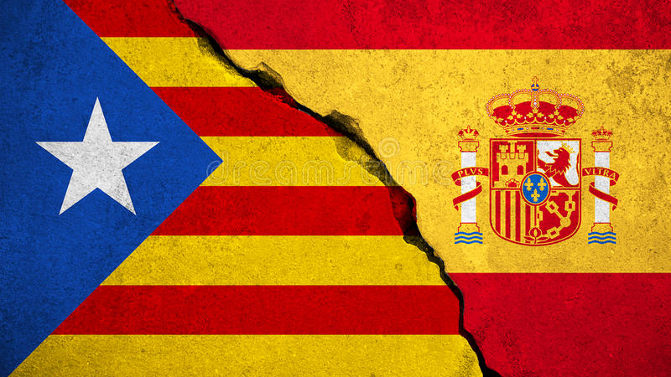
Catalonian Independence
A Test of Democracy

Slide 2
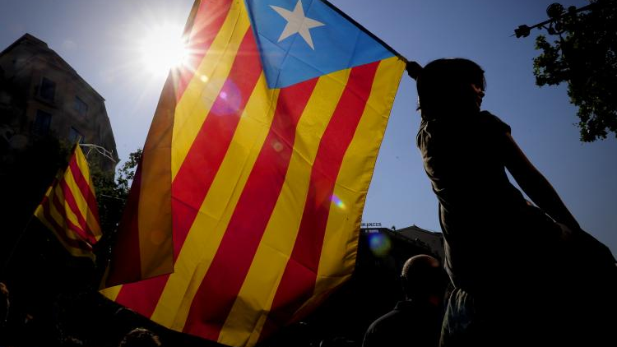
Origins of Independence
Catalonia has always been somewhat separate from the rest of Spain, from being a separate kingdom until the 15th century and choosing the losing side of a 1714 power struggle for the Iberian Peninsula
Catalonia has its own language and culture separate from the central Madrid government or Castille Leone
After the end of dictator Francisco Franco's rule in 1975 Catalonia has gained more and more autonomy while paying what many believe to be unfair amount of taxes

Slide 3
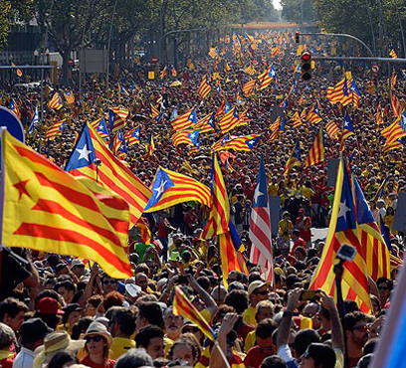
The Referendum
On October 1st Catalonia held a referendum to succeed from Spain
Spain deemed the vote unconstitutional and sent government forces to violently break it up
Despite the interference Catalonia voted 90% for independence and the Catalonian PM declared Independence

Slide 4
A Test of Democracy
Madrid has stated that they have no intention of letting go of a 226 billion dollar province, by any means necessary
They have dissolved the Catalan government, and sent large numbers of federal troops to the area
Many see Spain's response as a return to the authoritism only abandoned 30 years ago
Is it the right of the people to create their own nation?

Slide 5
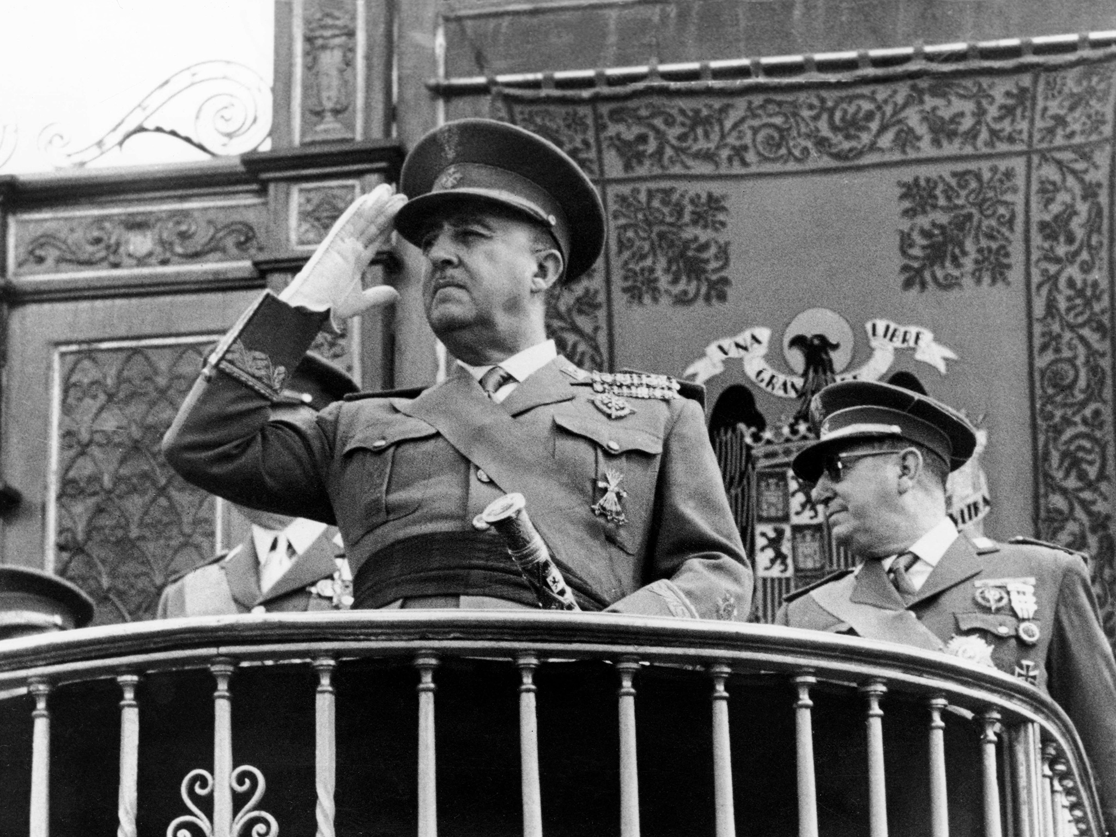
Relation to Animal Farm
In the novel the animals overthrow farmer Jones and create their own republic, however after some time the pigs establish a totalitarianism regime
This can be related to the events of Spain, a country that was a dictatorship until 1975 and has currently established an authoritarian rule in the Catalan region

