Slide 1
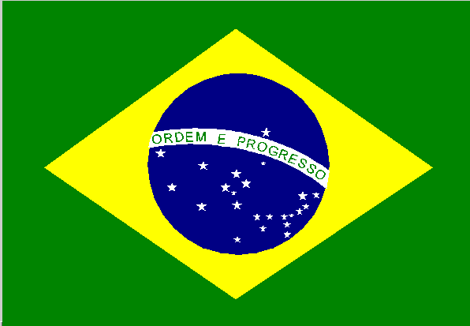
Rio de Janero
Henry Ferland

Slide 2
What Happened?
Over this past summer, Brazil, an incredibly impoverished country, spent billions of dollars on hosting the 2016 Rio Olympics.

Slide 3
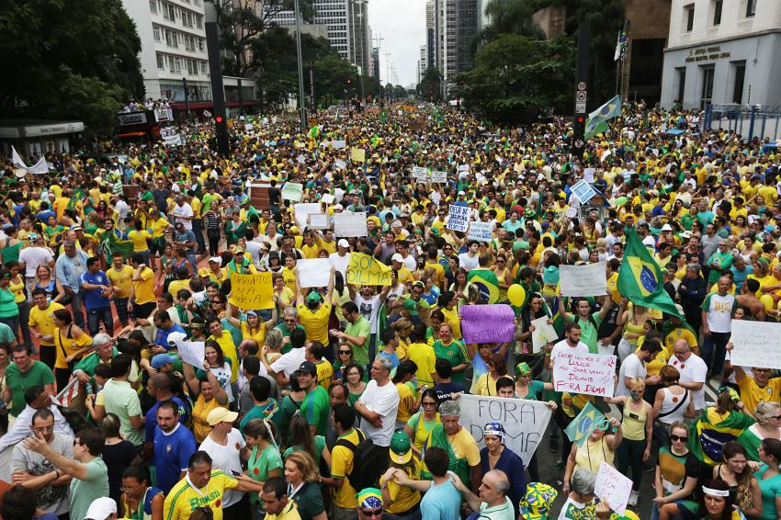
How did the people react?
The people of Rio, seeing how much money the Olympics cost, realized how badly it effected their economy. They began to protest. They were not only protesting the Olympics, but they were protesting their government. The people took to the streets with signs in protest of Brazils president Michael Tremer.

Slide 4
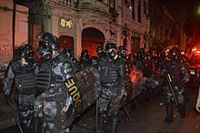
How did the government respond?
At first the government thought that the protest were just harmless parades. But as the protests got bigger and more extreme, the police started to use force to stop the protests. They used tear gas and stun grenades

Slide 5
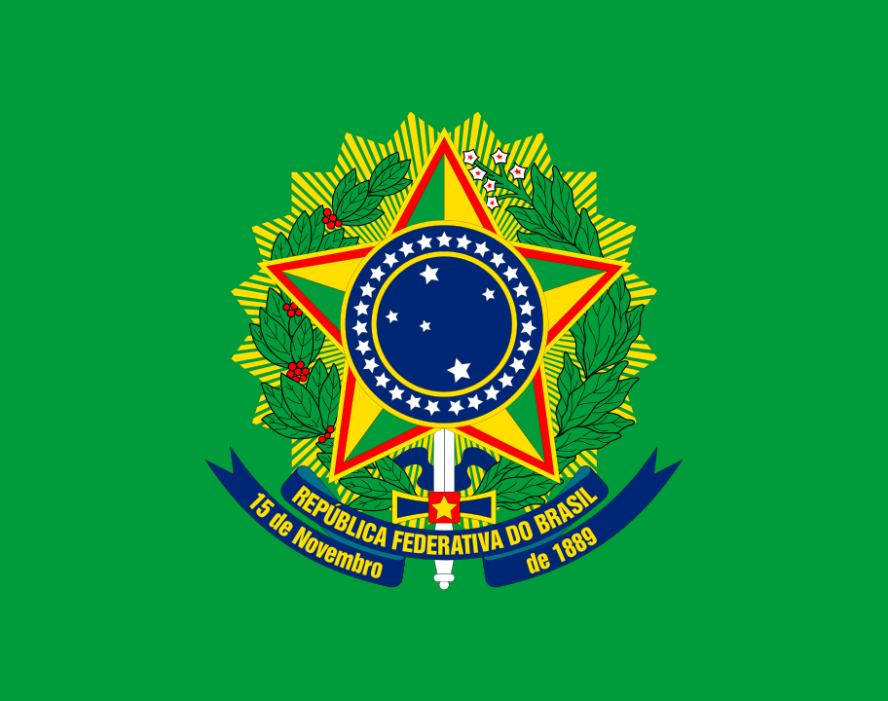
Brazils Government
Brazils government has corrupt for many years. Brazils former president, Dilma Roussoff, was suspended from her presidency because she was accused of hiding a budget deficit. The vice president, Michel Tremer, is serving as the interim president. An impeachment vote will be help after the Olympic games to permanently remove Tremer.

Slide 6
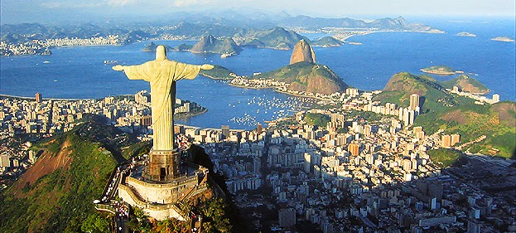
What's going on now?
Rio still had protests going on right now. Although the government has not changed anything because of the protests yet, the people of Rio showed the government that they still had a voice. One of the main reasons that they were protesting, was the re-election of Rousseff and of Tremer.

