Slide 1
Rohingya Genocide
By Hannah Spilhaus

Slide 2
The Rohingya Muslims
The Rohingya is the religious and ethnic muslim minority in Myanmar
1948 was the year that Myanmar got independence from the British
This was the first time that the Rohingya asked for citizenship and they were declined the right and called foreigners
1950 they staged their first rebellion for citizenship and equal rights against the police and government. The revolt was immediately crushed
1962 the military coup took over and started to kill, torture, rape, Burn villages and crops and behead the people Rohingya people
Form 1991 to now the Myanmar government continues to eradicate them.

Slide 3
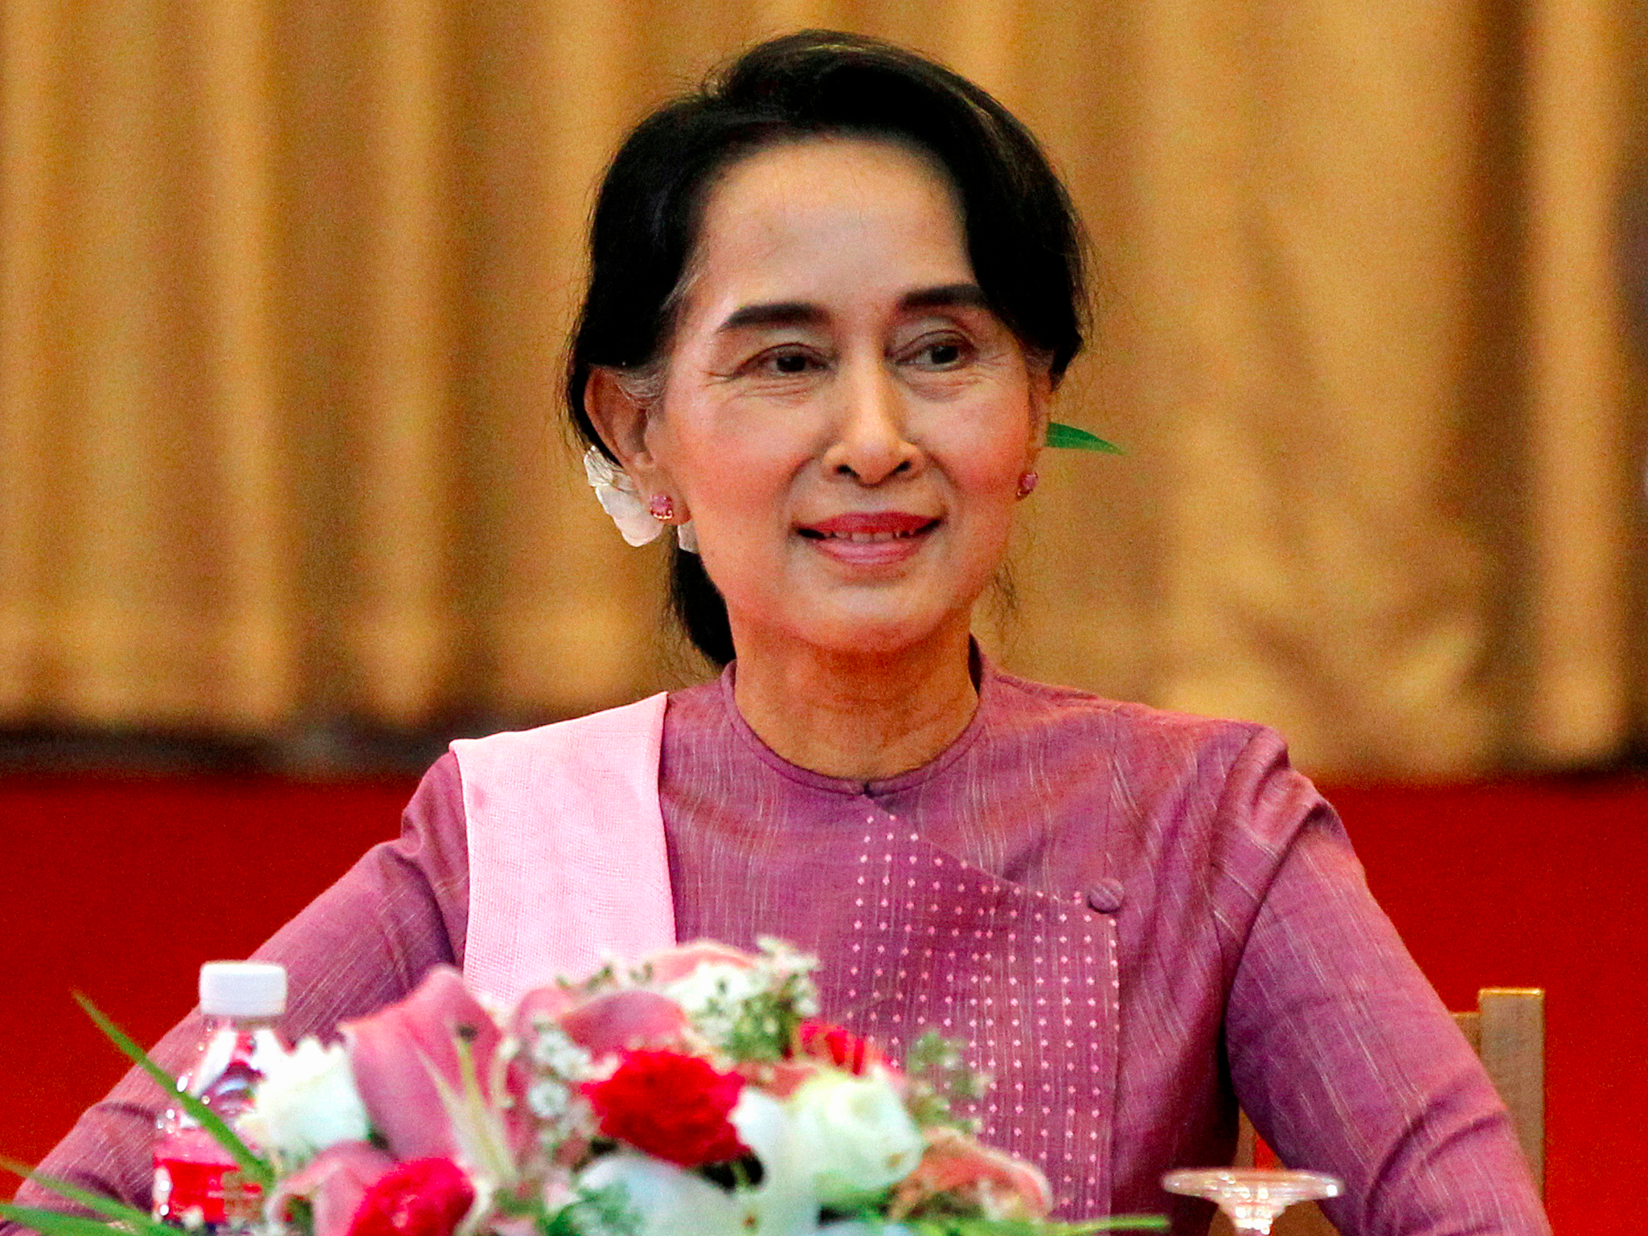
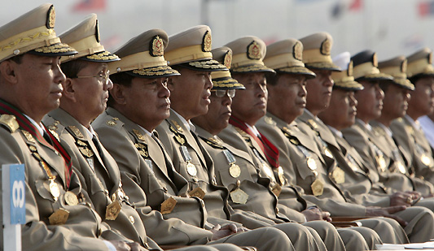
Who is involved ??
In my opinion i this that Suu Kyi should be using her government authority to stop the genocide that is occurring. The government is the group who is killing the Rohingya. They believe that there is no place in the world for them.
Aung San Suu Kyi is a Myanmar politician, diplomat, and author. She is the leader of the National League for Democracy and the first State Counsellor. She also is the a nobel peace prize winner. The united nations and other organizations and countries our pressure on her to make a statement about the “ethnic cleansing” happening in Myanmar. She is yet to release anything substantial and is saying that this is because she doesn't want her authoritative spot taken away.

Slide 4
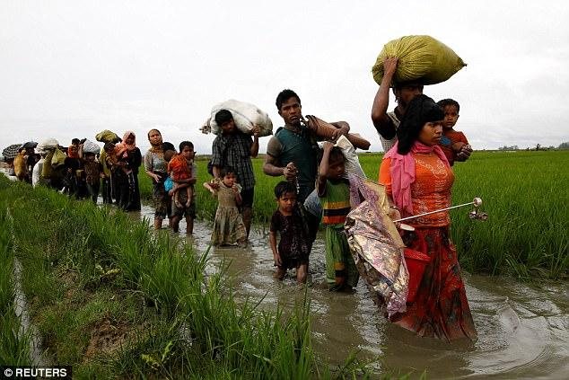
The Current Problem
Since the last report about 6 months ago the estimated number of Rohingyas that have fled to Bangladesh has risen from at least 123,000 to more than 400,000. Villiage our still being burned to the ground and peolle our still bein killing, raped, torture ans beheaded. The United nations has also said that the only help they can provide till Myanmar says is aid in the refugee camps on the borders or the country. As of August this summer this inhuman act has had controversy on being genocide. But as of september 10 it was given the title of an act of ethnic cleansing or genocide.

Slide 5
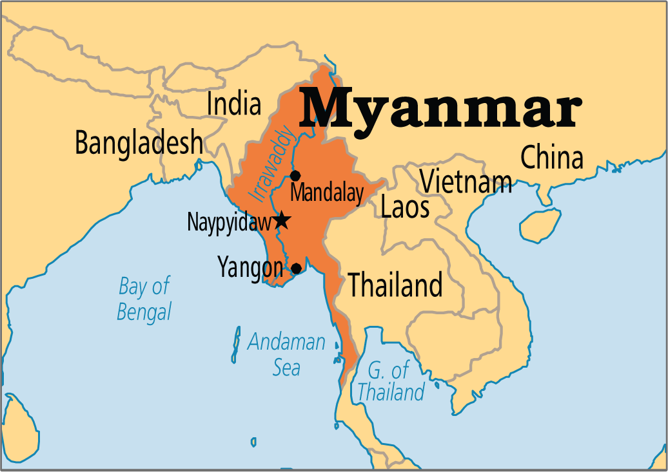
Where is Myanmar ???
Myanmar is located in the Southeast Asian region. Myanmar is bordered by India and Bangladesh to its west, Thailand and Laos to its east and China to its north and northeast. The majority of the Rohingya and refugeeing on the border of Thailand. The Rohingya our not only fleeing because of the torture s death but also because the government is burning the crops and eliminating the food source.

Slide 6
In conclusion the Rohingya people our being forced out of there homes and treated like slaves because they wanted to have equal right and a home. That is not only unfair but inhuman. I think that the myanmar government should stop this genocide and let the Rohingya become citizens and equal people. I think that the government is a lot like the pigs in animal farm. They are killing innocent people because they are not listening a lot like the pig did to the other animals. I also think that Aung San Suu is a lot like Moses the raven. She is allowed to stay and has little authority but never uses it.
Conclusion

