Slide 1
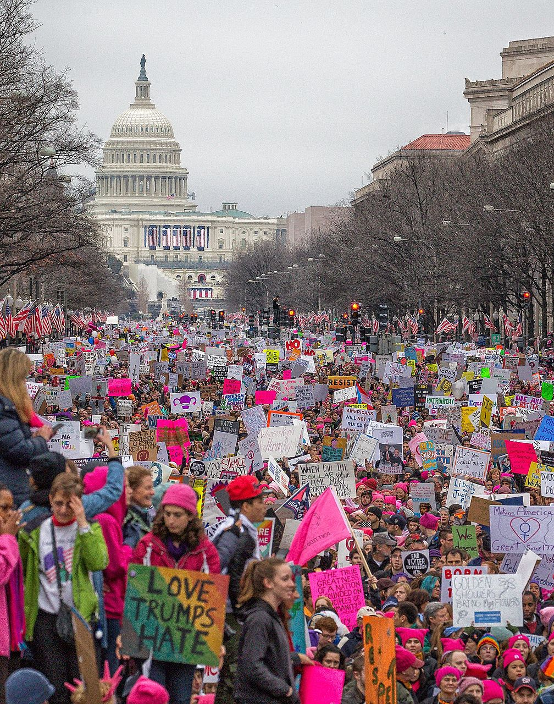
Woman's Rights March
By Olivia DePuy

Slide 2
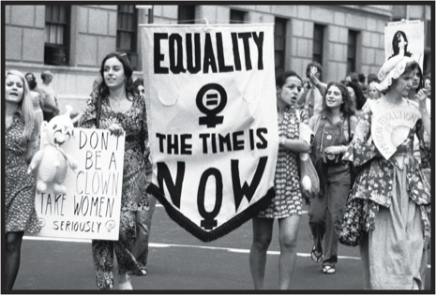
What Happened?
On January 21st 2017 more than 1 million people marched to show support for woman's rights and protest against President Trump. Protesting was meant to make change, to get people's attention and for the news to spread the conflict.

Slide 3
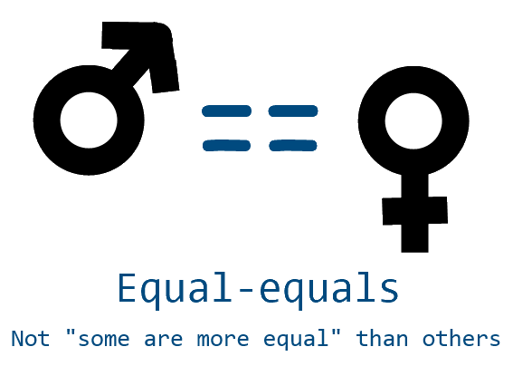
Why did people protest?
The protest was about how woman and men should be treated equal and to express the election of President Donald Trump. The common cause was wanting equality and standing up for what's right, to send a bold message.

Slide 4
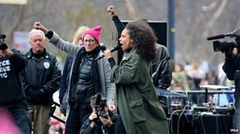
How was the protest organized?
The protest was planned for Washington D.C. A facebook page was made to let people know a march was being planned. Key players who helped were feminist icon Gloria Steinem and musician Alicia Keys.

Slide 5
Was the protest a success?
The protest was considered a success. It was peaceful, no arrest or armful acts. A list of speakers talked about fighting for equal rights and standing together in solidarity. The demands that were made were very understanding.

Slide 6
Was it all worth it?
There was an enormous turnout of people who helped show how many individuals follow these beliefs. There was no direct action that took place in response to this gathering. The protest was spread over the country which dragged attention towards the conflict.

