Slide 1
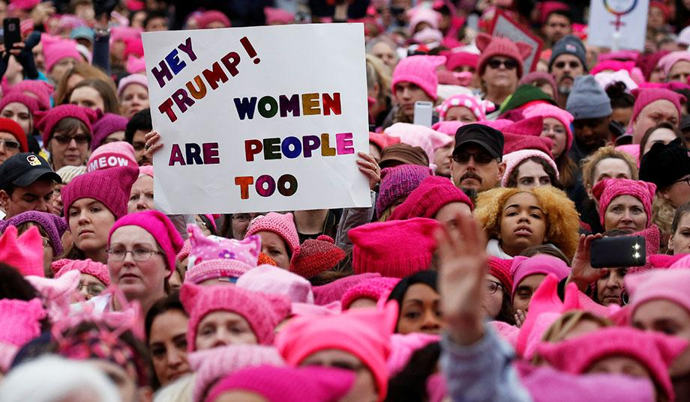
The Women's March By Josh Clinton

Slide 2
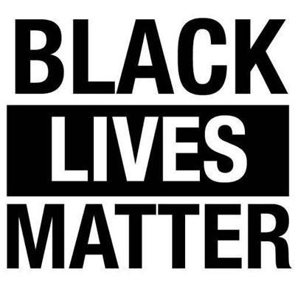
What happened?
The Women's March was a gathering primarily of women around the world. They focused on feminist issues. Many people joined the protest to stand against Trump and his presidency, but that was not the only reason. Some people were there to protest for Black Lives Matter (BLM), LGBTQIA+, and other causes and some were there to intimidate Trump and his hateful ways.

Slide 3
When and Where?
The largest march took place on January 21,2017 in Washington DC. This was the day after Trump was inaugurated President. Each of the fifty states had at least one march. In total, there were around 680 other marches in the U.S. alone. All seven continents had marches on the same day!

Slide 4
Who was there?
The Women's March involved between 3,267,134 and 5,246,670 people in the United States (the best estimate is 4,157,894). Famous people, such as Gloria Steinem, Michael Moore, Jane Fonda, Alicia Keys, Scarlett Johansson, John Lewis, and Miley Cyrus to name a few, participated in the marches across the United States.

Slide 5
Forms of Protest
During the Women's March, many women used pink knitted bennies called "pussy hats" to show solidarity. They also use signs with strong language and powerful meanings.
The March in Washington, along with all the other marches in the US, were peaceful, non-violent protests.

Slide 6
Animal Farm
In Animal Farm, by George Orwell, the animals retaliate against their hatred filled and selfish owner, Mr. Jones.
The book relates to the March on Washington because Mr. Jones is like Trump. They are divisive people, trying to kept classism, sexism and racism in the world. The animals in the book are similar to the woman who marched, as they both wanted to retaliate against their oppressors (Mr. Jones and Trump).

