Slide 1
Womens rights
Connor Ginn

Slide 2
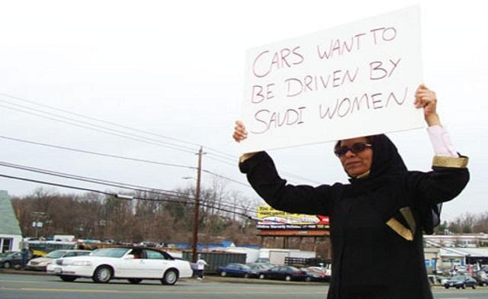
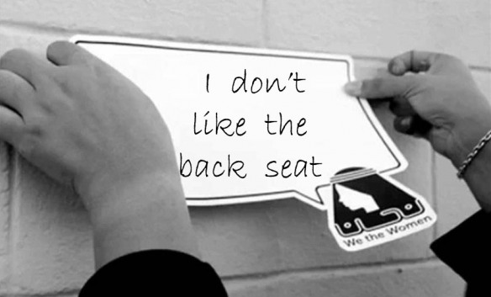
What happened?
The king of Saudi Arabia created a driving ban for women. The ban was crated in 1957. the ban was recently lifted allowing Saudi Arabian women to drive.

Slide 3
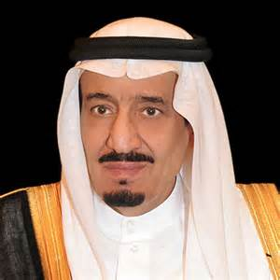
Who was involved?
During the protesting of the driving ban many people were involved. Almost all women involved are unknown. Some of the known women are Nourah Alghanem, Asma Alaboudi and Monera Alnahedh. The person with the most important role was King Salman.

Slide 4
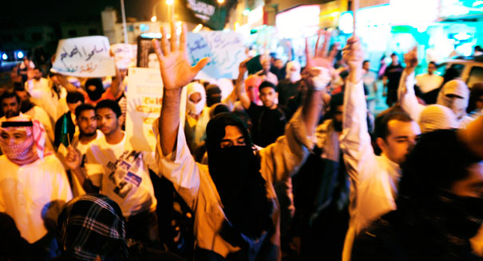
What did they do?
The many women of Saudi Arabia had organized multiple protests against this ban. When planned they has selected certain people with different tasks. The most important thing they did was many women had filled 15 cars and drove down to the capital.

Slide 5
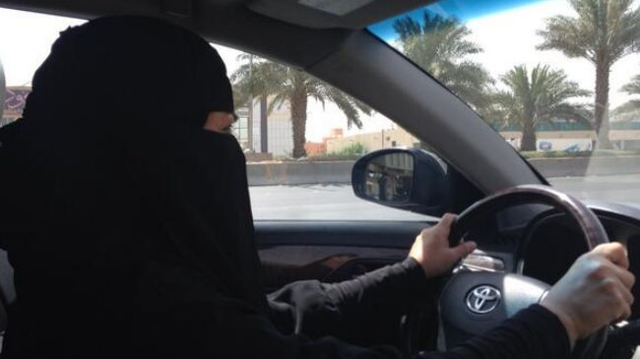
how did the government/king respond?
After several years of the protesting and the big stunt of driving to the capital the king gave in to their demands peacefully. To my knowledge the government did not use force against any of the women protestors.

Slide 6
Was it worth it/ what's happening now?
In the end I think that the protesting over the years was worth the allowing of women to drive in Saudi Arabia. The change from the uplifting of the ban has brought good change to Saudi Arabia because now there is more peace. And less rioting due to the driving ban.

Slide 7
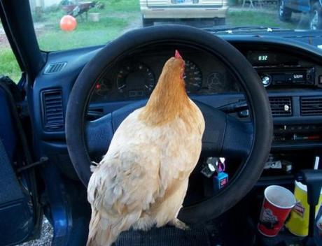
How it relates to animal farm?
In both animal farm and in the real world driving ban experience they both did rash things to accomplish their goals. Some things they both did were protest. And in this case the women driving to the capital is similar to the animals fighting back against Mr. Jones. In the end both are related due to the fact both the animals and the Saudi Arabian women stood against the rules and achieved their goals.

