Slide 1
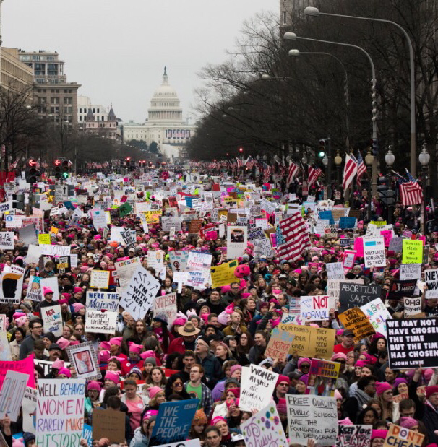
WOMEN’S MARCH ON WASHINGTON
By Kira Wheeler

Slide 2
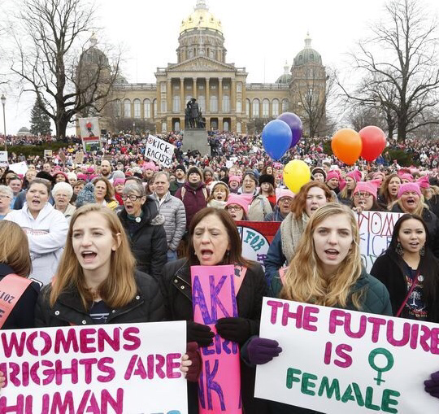
WHEN AND WHERE:
The main women’s march took place in Washington DC on January 21, 2017. However, there were around 680 other marches in the US alone. Each of the fifty states had at least one march and the New York City and the Los Angeles march had numbers comparable to the DC march. Worldwide, there were 137 marches in 56 countries.

Slide 3
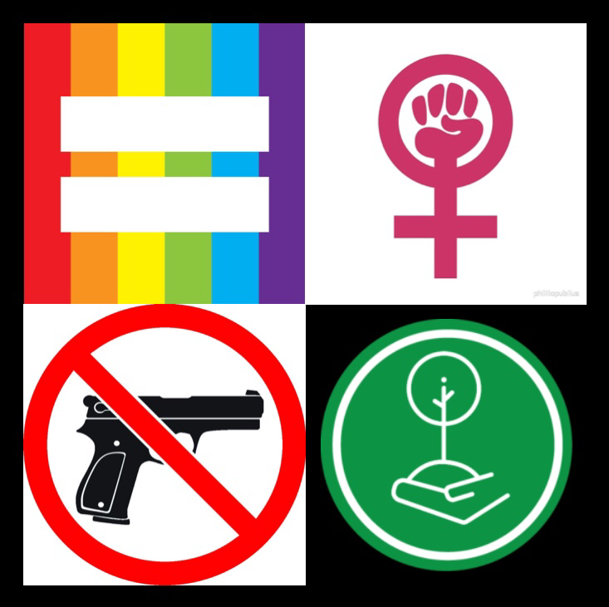
WHAT AND WHY:
The women’s march on Washington was a gathering of pro feminist, equal rights advocates. Most of the protests were aimed at Donald Trump and his then position as president. Some people also protested for ending violence, reproductive rights, LGBTQIA+ rights, workers rights, civil rights, disability rights, immigrant rights, and environmental justice.

Slide 4
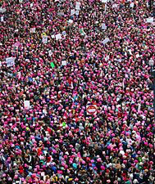
WHO AND HOW:
The Women’s March on Washington was originally a Facebook post. But, with the help of co-presidents Tamika D. Mallory and Bob Bland, it soon grew into an international sensation with over 400,000 attending the march in Washington and even more in other cities. Some celebrities like Scarlett Johansson, Alicia Keys, and Miley Cyrus even participated in various marches across the country.

Slide 5
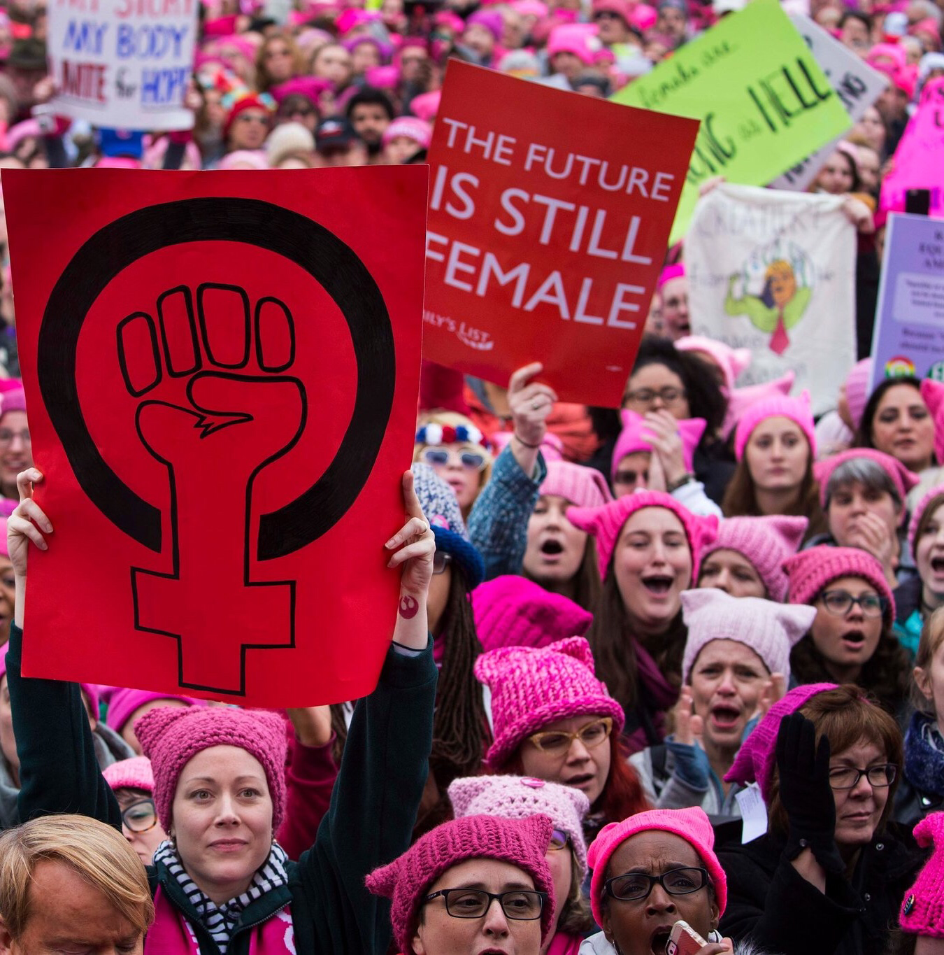
HATS AND SIGNS:
“Pussy hats” and protest signs were a big part of the Women’s March on Washington. During the protest, many people wore pink knitted beanies called “pussy hats” as a sign of solidarity. Many people also made signs with powerful messages and images on them.

Slide 6
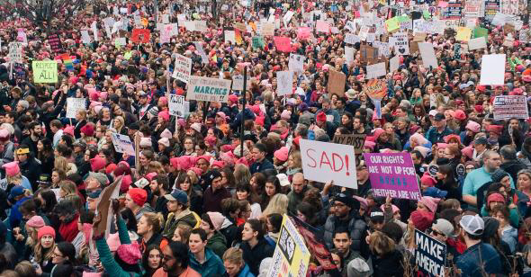
ANIMAL FARM:
In Animal Farm by George Orwell, the animals revolt because they feel that the farmer, Mr. Jones, has been running the farm unfairly and the animals feel they could have it better. One reason for the Women’s March on Washington is because the women did not feel listened to by the government and felt oppressed. Mr. Jones is to the animals as society and the government are to the women.

