Slide 1
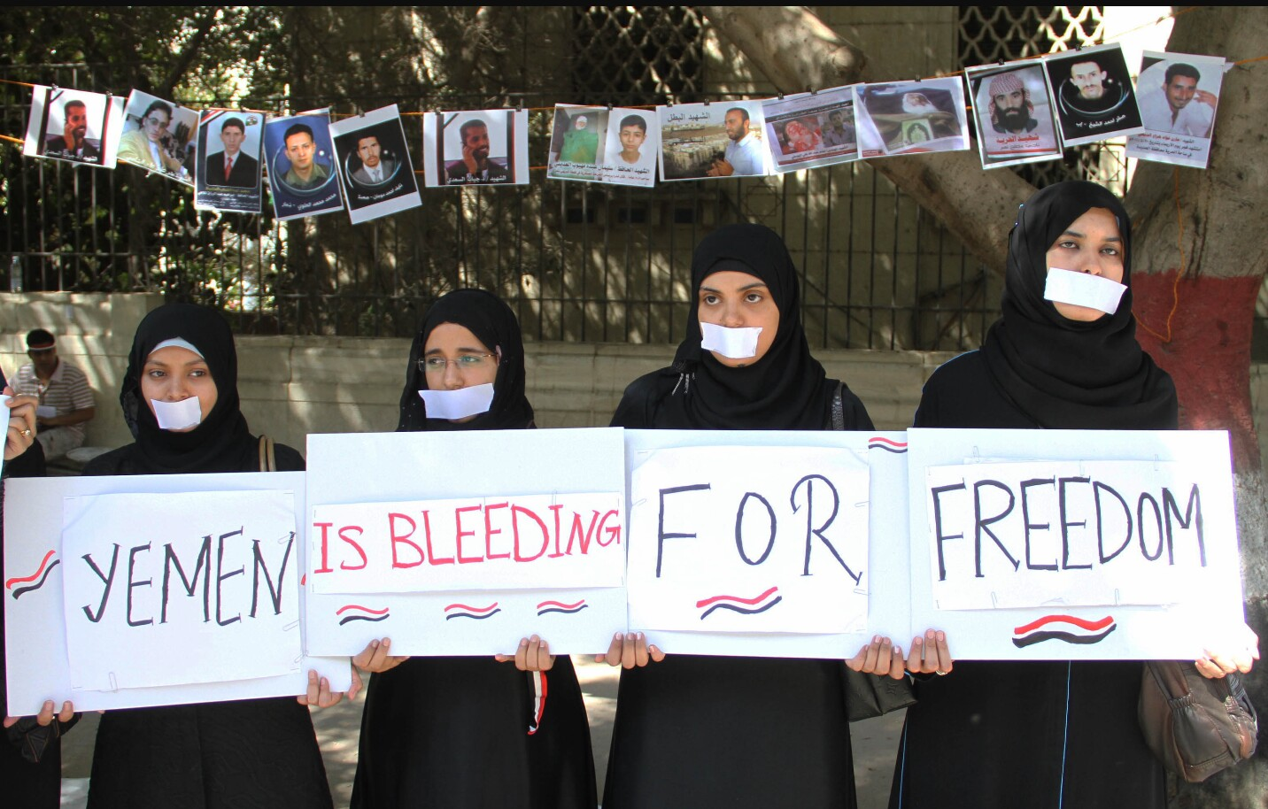
Yemeni Revolution
By Elijah Tamarchenko

Slide 2
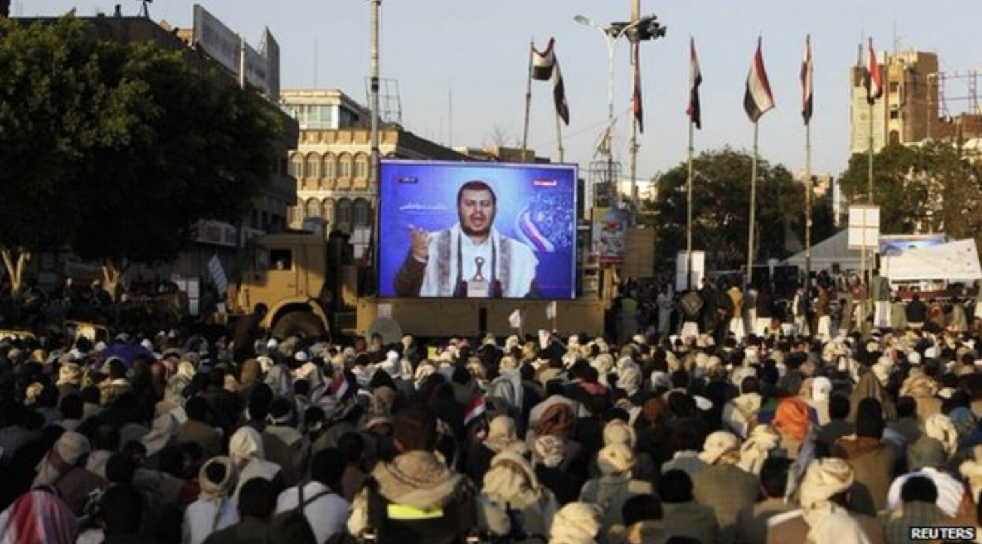
Causes
Before the Yemeni revolution began, Yemen was ruled by corrupted officials, who were looking to increase their power. The economy was crashing, and the government wanted to alter the constitution to their own benefit. Many people were opposed against this, and many groups, including the Houthis, started preaching a new way of life, without a corrupt government.

Slide 3
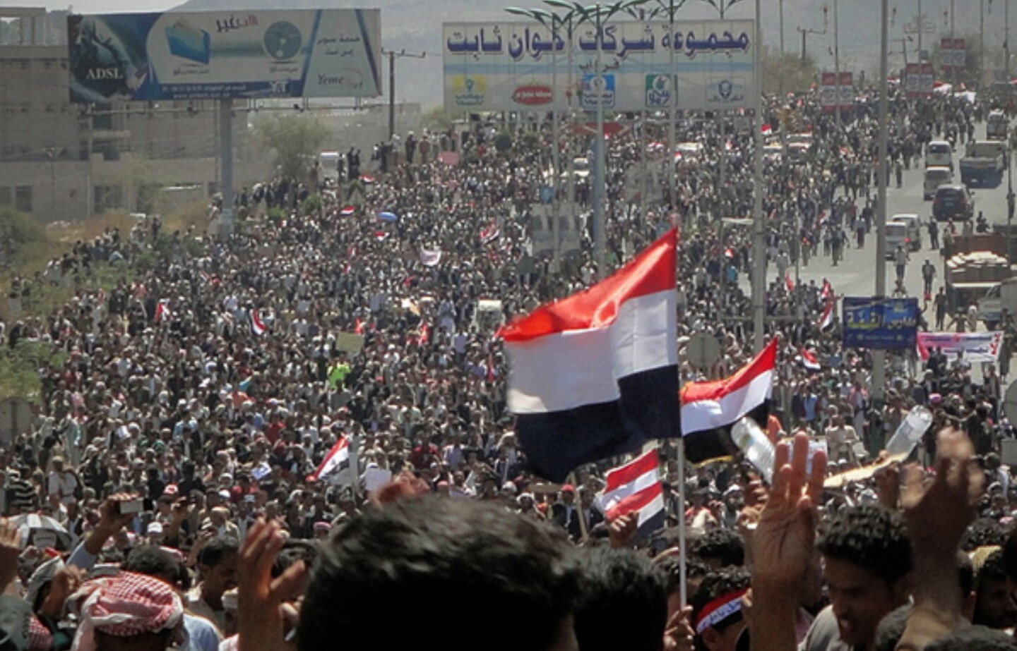
Yemen in revolution
After gathering enough followers, the Houthis started revolting, organizing protests against the preaident in the streets, painting on walls and continuously praising their ways. The government had no idea what to do, so they sent police and the military in after them, and sometimes the latter would shoot into crowds to get them to disperse, creating even more chaos and violence.
A protest in the streets of the capital, Sana‘a

Slide 4
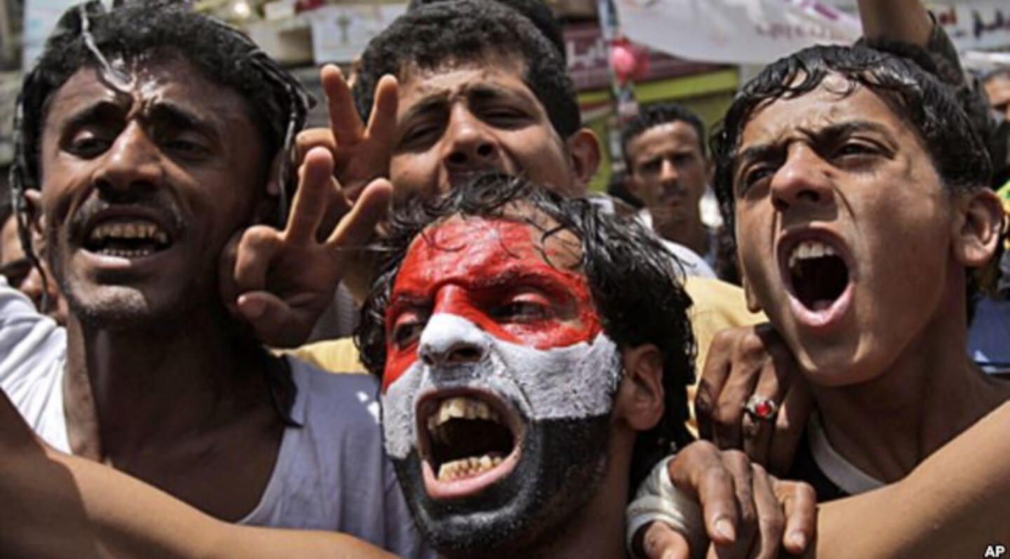
Effects
Yemen is still fighting its civil war, but many factors have changed since the beginning of it. The Houthis took over many parts of Yemen, and are still protesting against the government. The old Yemeni president, Saleh, was overthrown, and a new President was elected, Rabbur Mansuh Al-Hadi. Now Yemen is divided between two governments, the north and south, which oppose each other. Now many more groups, not only the Houthis, are looking to stop the government. Only time will tell if the revolution was worth the fight.

Slide 5
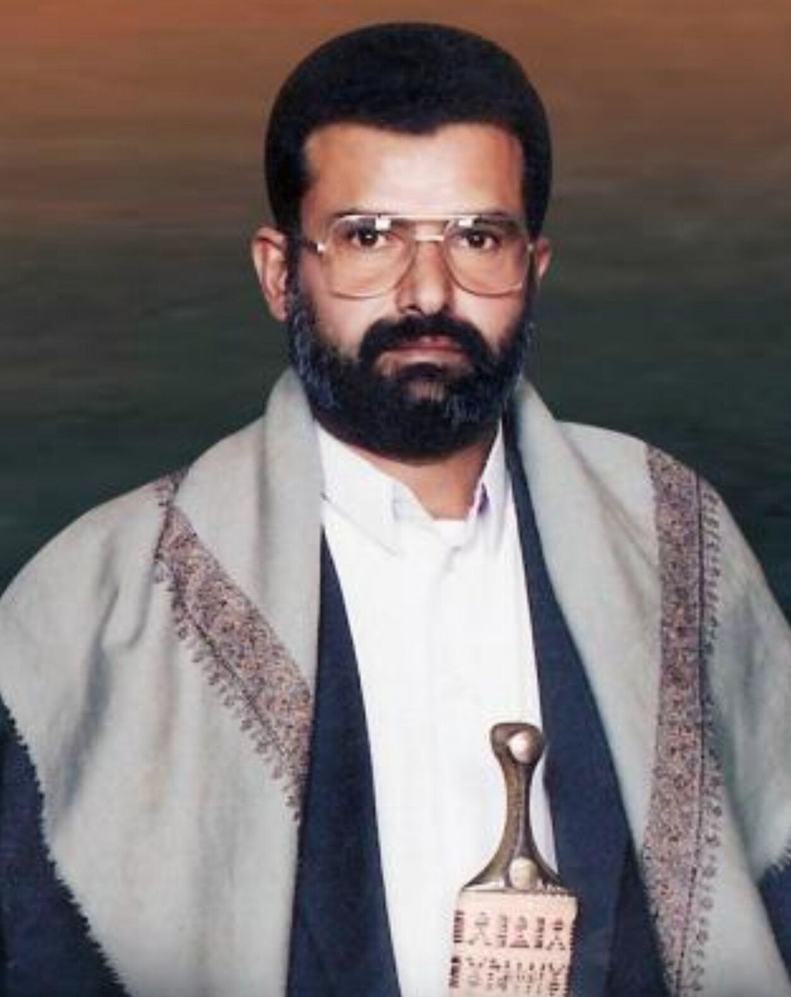
Connections to animal farm
Hussein Badreddin Al-Houthi, the founder of the Houthis, who was later Killed by Yemeni police, most resembles Old Major, the boar who started the revolt in animal farm. Hussein Rallied the Houthis together and preached about overthrowing the government. Old major told the animals on animal farm about a dream he had that they were free. They both told of a better life, and in the end died before they could see the fruits of their work. Old Major and Hussein are very similar, being the roots of both of their revolutions, but they both did not predict how much the conflict would escalate.

